Slide 1
Communication
Communication is an exchange of information
Types of communication:
  Verbal
  Non-verbal
Notes:
Verbal communication – is dependent on an exchange of words. These words can be spoken, written and/or signed where there is a hearing and/or speech impairment. Speech includes verbal nuances such as: tone and/or volume of voice, emotion, speaking style, rhythm, intonation, and stress. In written texts this is shown by: handwriting style, spatial arrangement of words, use of Capital and/or emboldened words, use of emoticons.
Non-verbal (or non word using) communication – such as gestures, tone of voice, body language, facial expression, head nods, posture, eye contact, clothing, hairstyles, etc.
Effective Communication of any kind involves a two way process because there has to be one person giving the information and another one receiving it. For any kind of communication to be effective both parties are equally important and both must be able to receive and impart information appropriately and effectively – not always easy to achieve!

Slide 2
Effective communication requires:
working in partnership
being open, authentic and honest
good listening skills
being non-judgmental
seeking clarification when you need it
observing
not making assumptions
Notes:
working in partnership without dominating or being dominated i.e. both parties are equally important
being open, authentic and honest - keep in mind the uniqueness of the person you are communicating with
good listening skills – being an active listener where you engage in the conversation rather than passively listening - see the handout about ‘active listening’
being non-judgmental/ not allowing your attitudes to be an overwhelming influence
seeking clarification when you need it – reflecting back what the person has said and asking if that was what the person intended you to receive.
observing behaviour and body language so that you get the full picture
Not making assumptions – about another persons ability to communicate – make sure you know what the most effective method of communication is for them. Don’t make assumptions about what you think the person is saying or going to say – give them time to communicate, limit interruptions, be an active listener, use reflective techniques for clarification – if you are not sure about what is being said ASK.

Slide 3
Key aspects of effective communication
What do think you can do for effective communication with your mentee?
Identify appropriate method of communication
Send and receive verbal & non-verbal messages
Keep good eye contact, but don’t stare
Be patient
Focus
Create the right atmosphere
Use ‘open’ questions
Be self-aware of your own non-verbal signals – do
Notes:
Identifying the most appropriate method of communication and help the person to feel as relaxed and comfortable as possible
Sending and receiving messages to achieve a purpose. In most conversations we continually move backwards and forwards between the role of Sender and Receiver.
Sharing ideas, thoughts, opinions, information, feelings, etc.
Making appropriate eye contact – good listeners keep eye contact for one third of the time or more BUT overdoing this can make you or the other person self conscious and can feel intimidating. When talking to a child or a person is in a wheelchair being at the same physical eye level can allow for better conversation
Being patient, do not interrupt or finish sentences off for others – give people time to speak for themselves.
Focusing on what is being said, intonations, expressions, body language, gestures, etc. It is not allowing your self to be distracted.
Creating the right atmosphere to allow the conversation to develop. A smile; encouraging nod; or making a reflective or supportive comment such as “Yes, I can hear that you were feeling upset about . . . .”; “What I am hearing is that you are finding that difficult, is that right?”, shows that you are paying attention and helps to reinforce their belief that you are willing to listen and consider what is being said. If you are uncertain about what is being said, ask for clarification. By doing this you avoid the person feeling that it is their fault you don’t understand which could inhibit further conversation.
Using ‘open’ questions encourages two-way conversation An ‘open’ question is one that cannot be answered with ‘yes’ or ‘no’. For example, Open question – ‘What did you think about the food? Closed question ‘Did you enjoy your dinner?’ Open questions normally start with the following words – how, who, where, why, when or what. It takes practice, particularly if the other person is not in a talkative mood so have an activity (such as - walking, craft, cooking) ) that you can do together or at least alongside each other to allow your relationship to develop.
Being aware of your own facial expressions and body language – make sure you are giving the message that you want to send e.g. raising eyebrows in surprise, looking puzzled, nodding or shaking your head can be useful in providing encouragement, but in some situations, if you look surprised or shocked you may stop the other person talking and lose the opportunity for a conversation. Be careful not to give the impression that you are judging the individual.

Slide 4
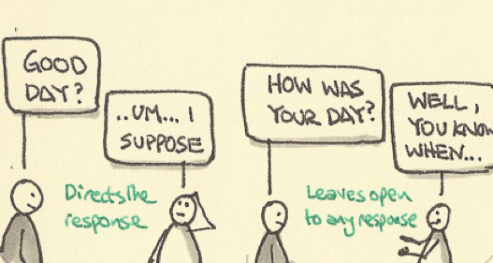
Open-ended questions

Slide 5
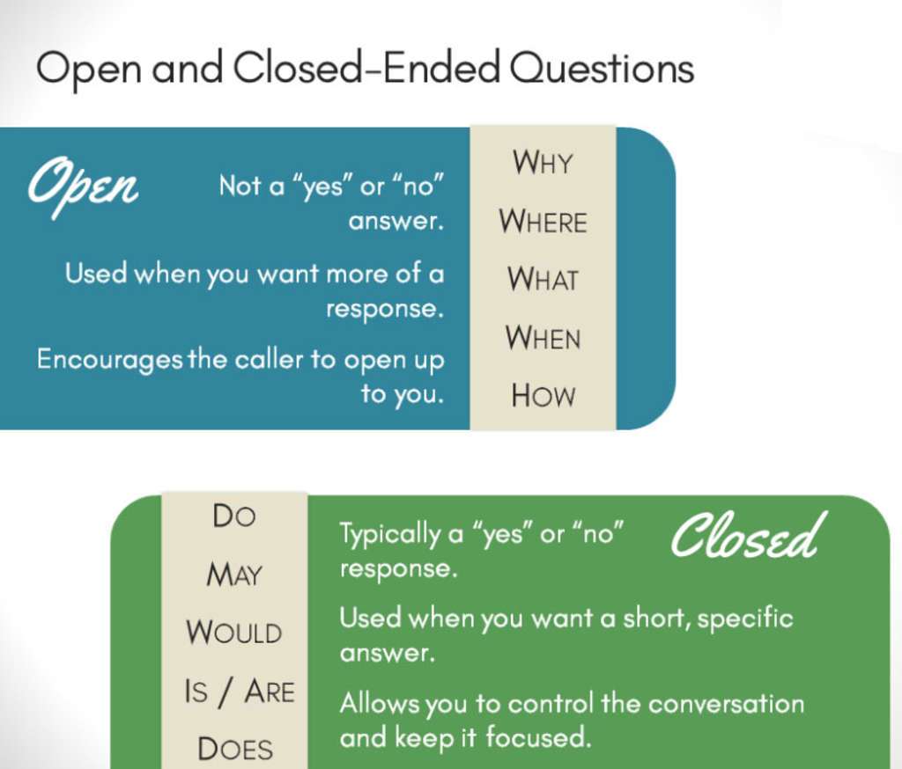
ACTIVITY
Turn these question into more open questions:
Did you have a good weekend?
Do you like watching sitcoms?
3. Does it annoy you when your brother does that?
4. Are you ok?

Slide 6
Active listening
There are basically two types of listening:
Passively hearing the spoken words without processing the information being imparted.
Actively listening to what is said, processing it and engaging with it.
Notes:
Being an active listener is key to communicating effectively.
An active listener is someone who feedbacks both verbally and with their body language to show that they are listening and understanding what they are being told.
By actively listening you are able to show the speaker that they have successfully imparted the information that they intended to communicate to you. This encourages the person to communicate further because they know their thoughts and feelings are being recognised.
Active listening helps to build good relationships, solve problems and resolve conflicts.

Slide 7
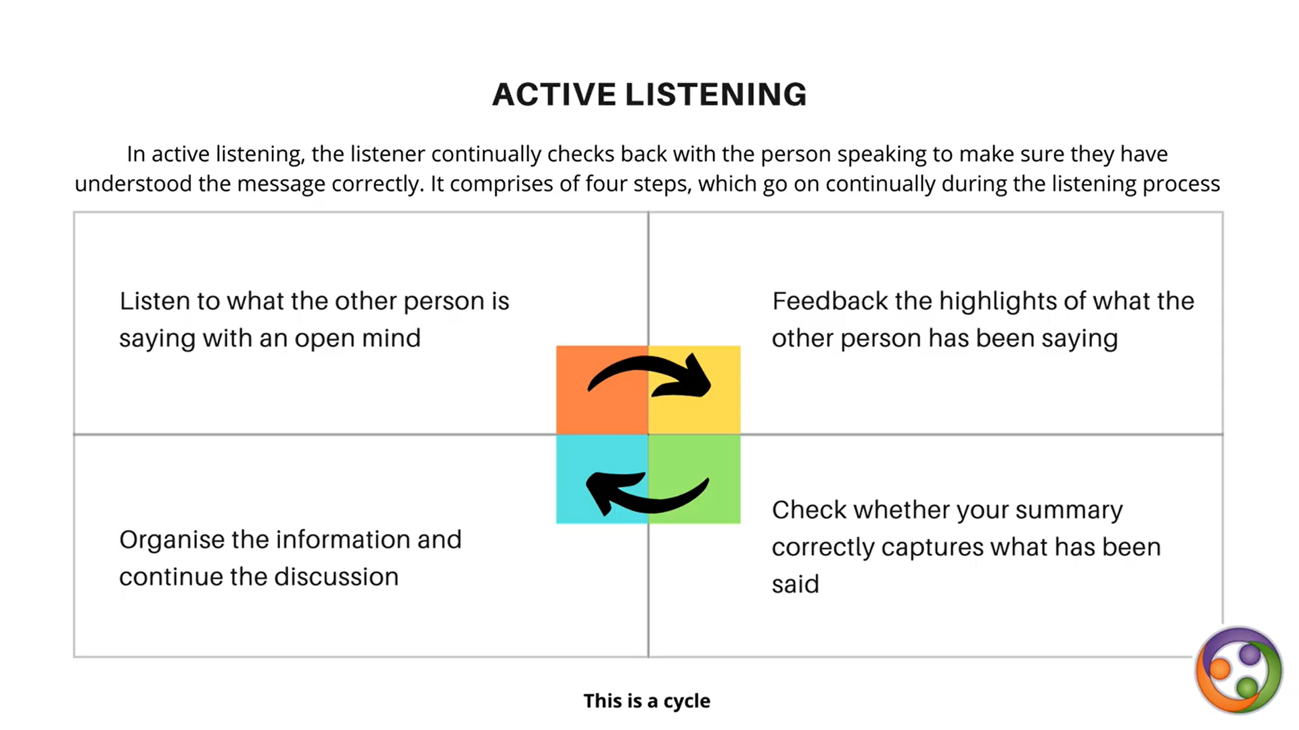


Slide 8
The hard part of being an active listener
is not stepping in with your solution to the young person’s problem – even if you have one!
accepting and respecting the young person as a separate individual
listening quietly and patiently even when you do not agree with or approve of what is being said
enduring occasional silences and giving the young person the opportunity to fill these
Notes:
Point 1 - Often our first impulse is to jump in with reassurance or advice to the service user who is unhappy about something or with criticism and feedback when they get it wrong.
Point 2 - To really actively listen you need to be able to accept and respect the service user as a separate individual in their own right.
Point 3 – Often this means listening quietly even when they say things that you do not agree with or approve of.
If ‘active listening’ is to work - there are certain responses that should NOT be used; these include – ordering, threatening, moralising, lecturing, judging, name calling, diagnosing and/or interrogating – even responses such as advising, reassuring, praising and distracting should be limited until the person has had the space and time they need to say what they wanted to say.
Reflecting back to the service user what you think they are trying to say, without making any judgements, allows them to give clarification if your understanding is not what they meant and helps them to know that you are actively listening and really want to hear what they have to say. For example they might say – “I’m always getting it wrong, I just don’t know what I’m doing; I ask but nobody ever listens to me so what’s the point in even trying!” You could reply by saying – “I can hear from what you are saying that you are struggling with this and that you feeling very frustrated. I want to hear what you have to say. Can you explain to me what you want to do/achieve/say and we can discuss it together?”

Slide 9
Barriers to active listening
What do you think can be barriers to active listening?
Time
State of mind
Disabilities
Difficulties
Technology
Notes:
Active listening is a key aspect of effective communication and it does not just happen in a vacuum – there are a number of barriers to active listening, for example: -
Time – You have to take time to listen. If you rush around from one commitment to another or your head is full of plans, schemes or anxieties then it is difficult to keep focused. Effective listening requires you to take time, suspend the thoughts that are buzzing around in your head and offer the person you are listening to your complete attention.
State of mind – Worries, fears, anger, grief, depression all impact on how we listen to others.
Disabilities – hearing loss, speech impairment (including stutters, stammers, etc)
Difficulties – Things like individual bias and prejudice, semantics and language differences (including accents and dialects), preoccupation, boredom, noise and verbal ‘clutter’ can all cause difficulties between the speaker and the listener which will impact on the skill of actively listening to what is being said.
Technology – With the advances in technology we now have new barriers to effective listening as emails and texts take over from direct conversations. Messages sent electronically can be misconstrued as the ‘listener’ is unable to see the person they are communicating with to ‘read’ their body language and to hear the inflection in their voice as they speak.

Slide 10
ACTIVITY
Hearing between the lines
Listen to the following phrases being read out.
PART I: Write down what you think the feelings and emotions are behind the words.
Do these match up to the words being used?
PART II: Listen to the phrases being read out again. Using active listening, how would you respond to each statement?
Can you also use non-verbal communication to respond? How?
Notes:
The same words can be used but with different emotion or feeling behind the words; the body language being displayed and/or the tone, pitch and volume of the speakers voice changes then these same words can convey a completely different message.
The following information is on the handout:
For example: a child/young person says . . .
‘I don’t know what’s wrong, I can’t work it out, maybe I’ll just stop trying.’
Child is feeling despondent, useless, confused.
‘Woohoo, only 10 days to go until the school holidays’
‘Look dad, I’ve made an aeroplane with my tools’
‘I’m not having any fun, I can’t think of anything to do’
‘I’ll never be good like Jim, I practice and practice and never get any better’
‘My teacher gives us too much homework. I’ll never get it all done. What will I do?’
‘All the other kids have gone to the beach. I don’t have anyone to play with’
‘Go away and leave me alone. I don’t want to talk to you or anyone else. You don’t care what happens to me’

Slide 11
REFLECTIVE QUESTIONS I
Why do you think asking open questions and listening actively is important as an intandem mentor?
How do you think communicating with your mentee – especially over the phone or online – will be different to communicating with your friends or colleagues?

Slide 12
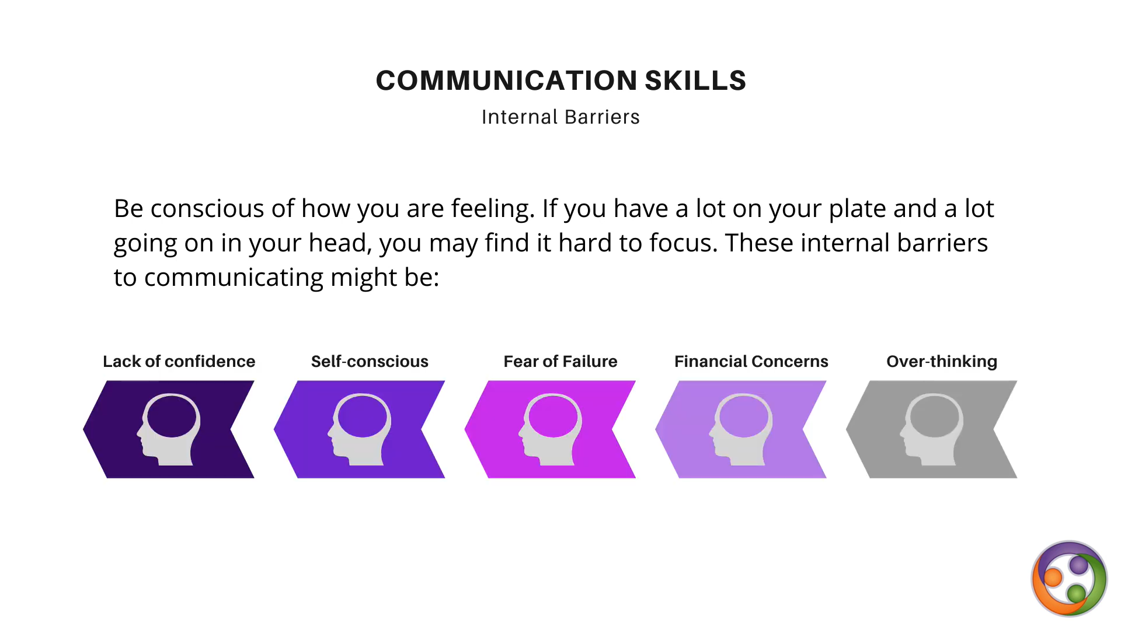

Slide 13
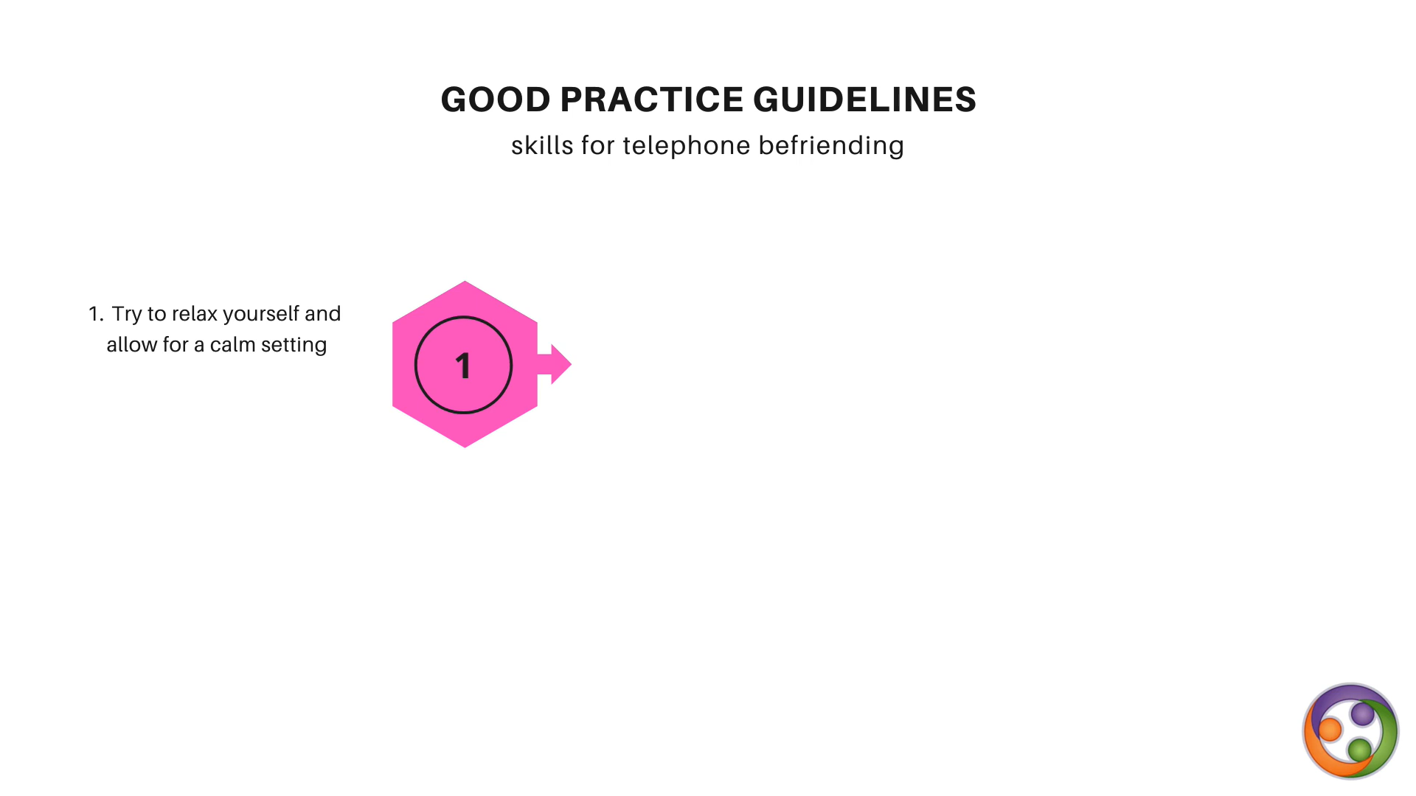
mentoring at a distance

Slide 14
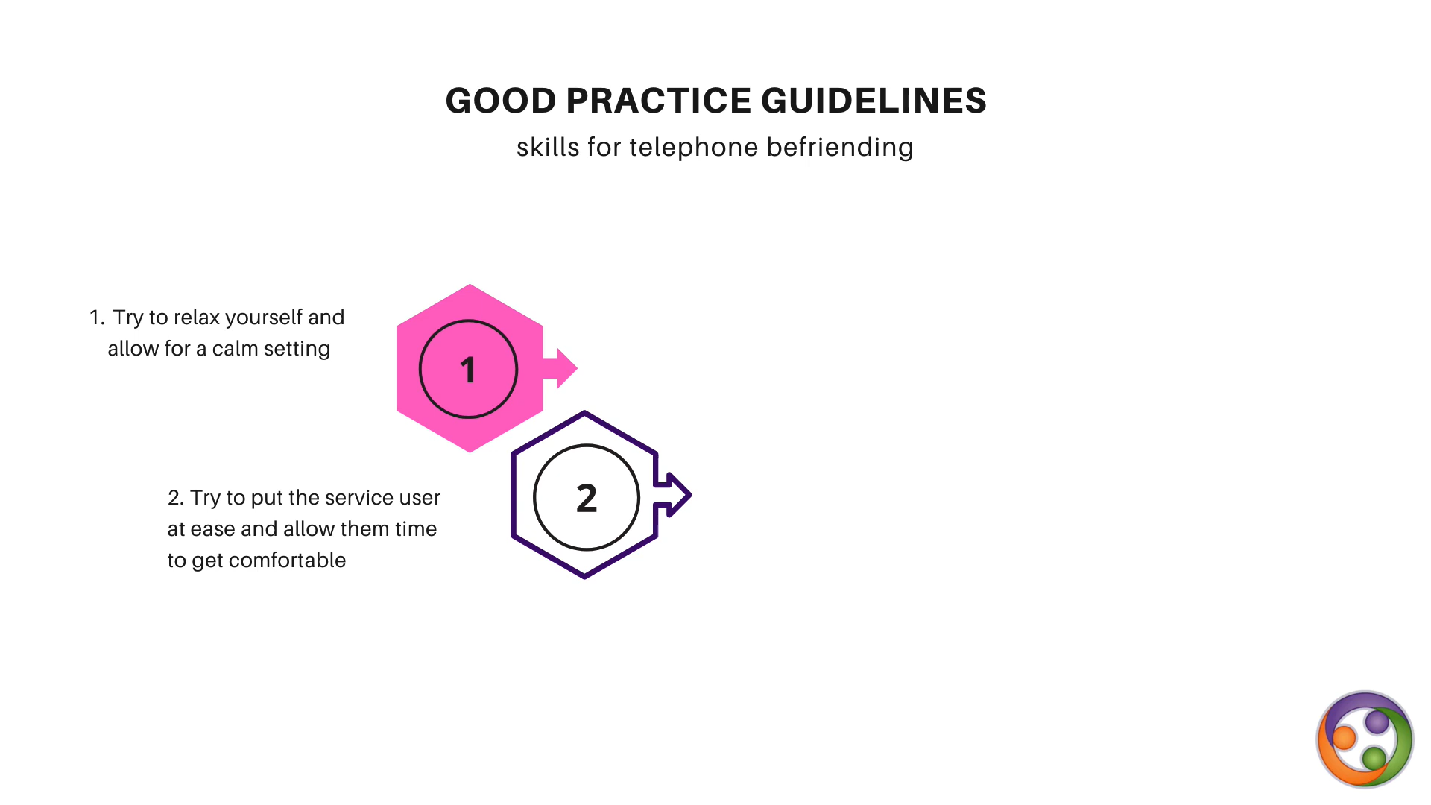
mentoring at a distance
mentoring at a distance
your mentee

Slide 15
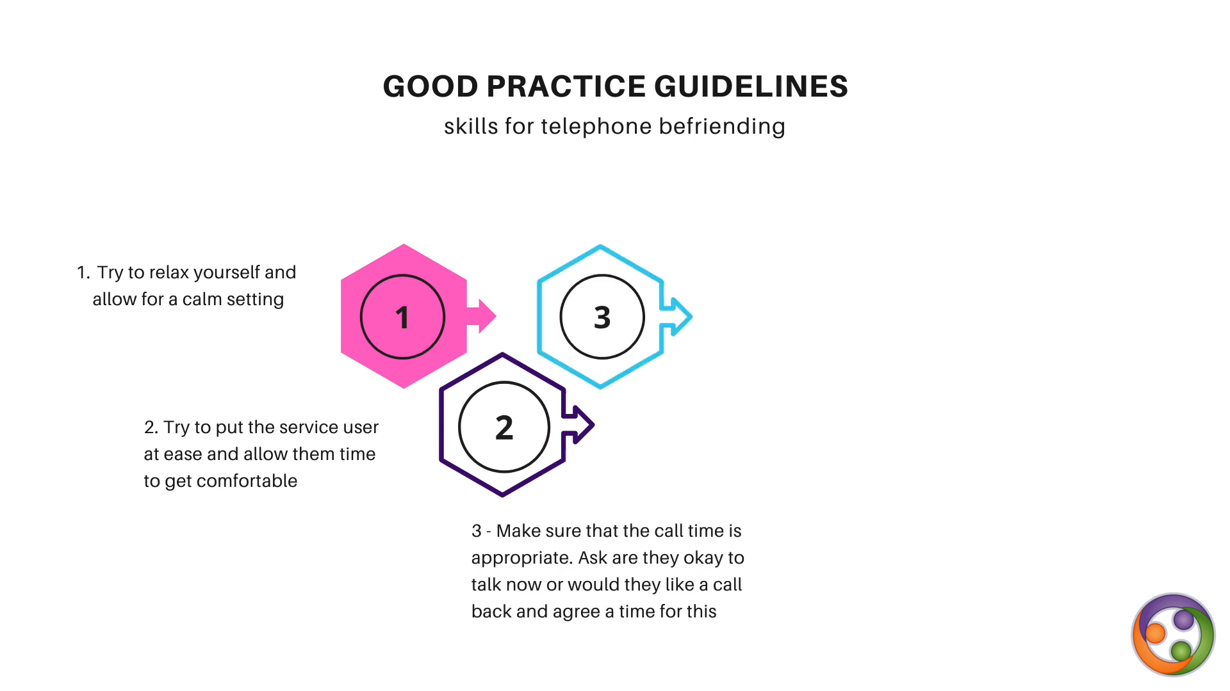
mentoring at a distance
mentoring at a distance
your mentee

Slide 16
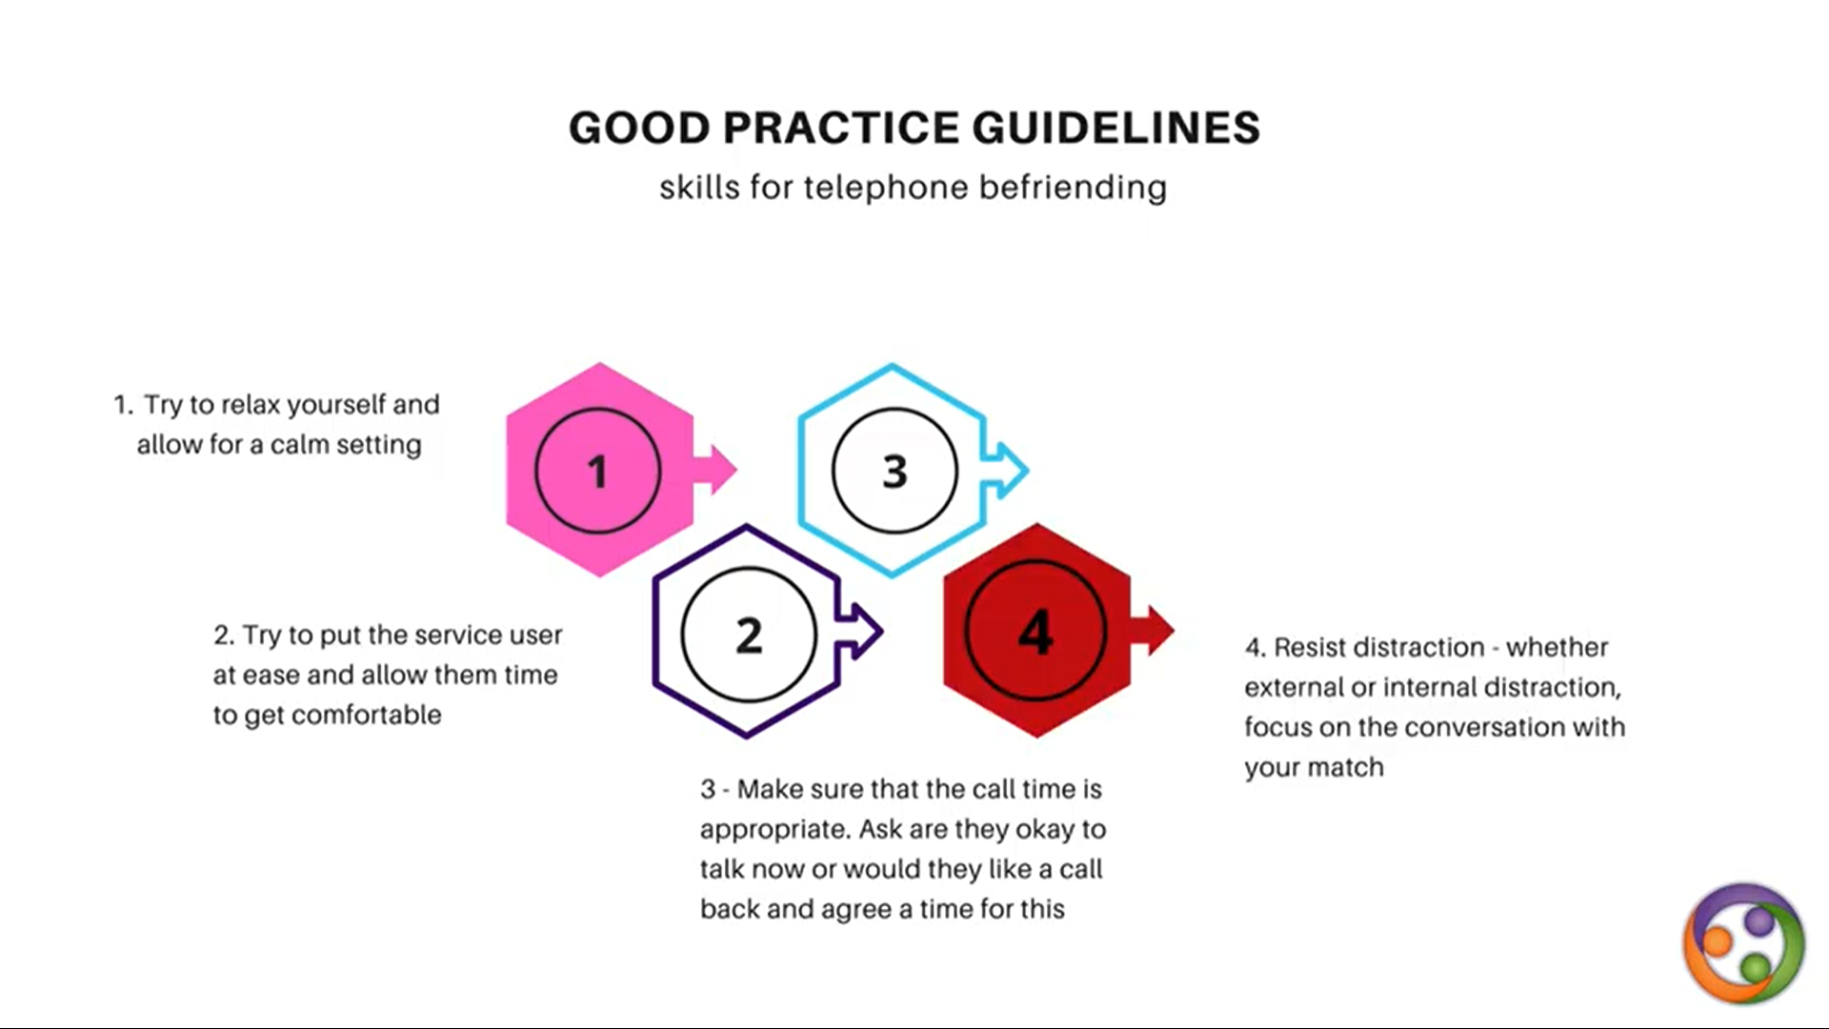
mentoring at a distance
mentoring at a distance
your mentee

Slide 17
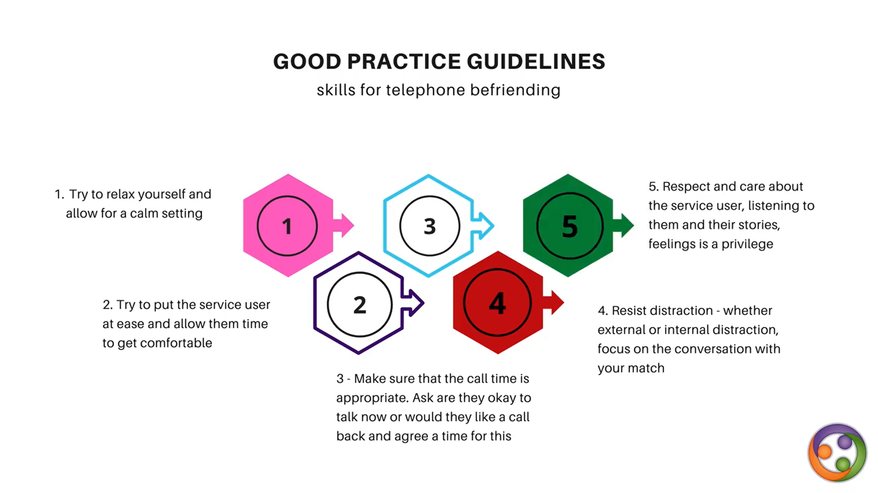
mentoring at a distance
mentoring at a distance
your mentee,
your mentee

Slide 18
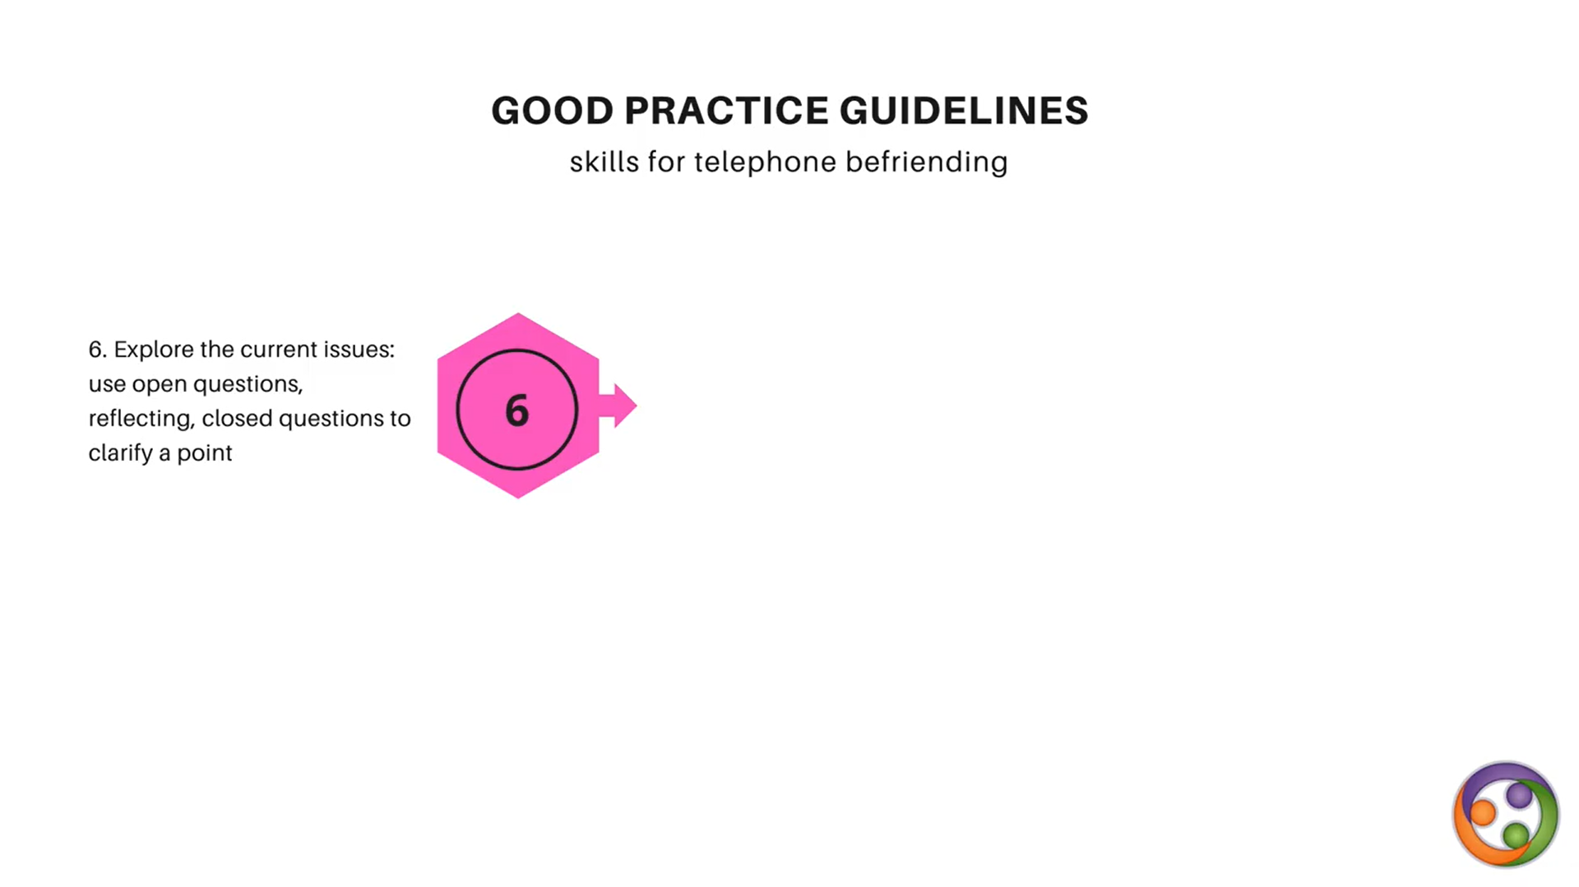
mentoring at a distance
mentoring at a distance

Slide 19
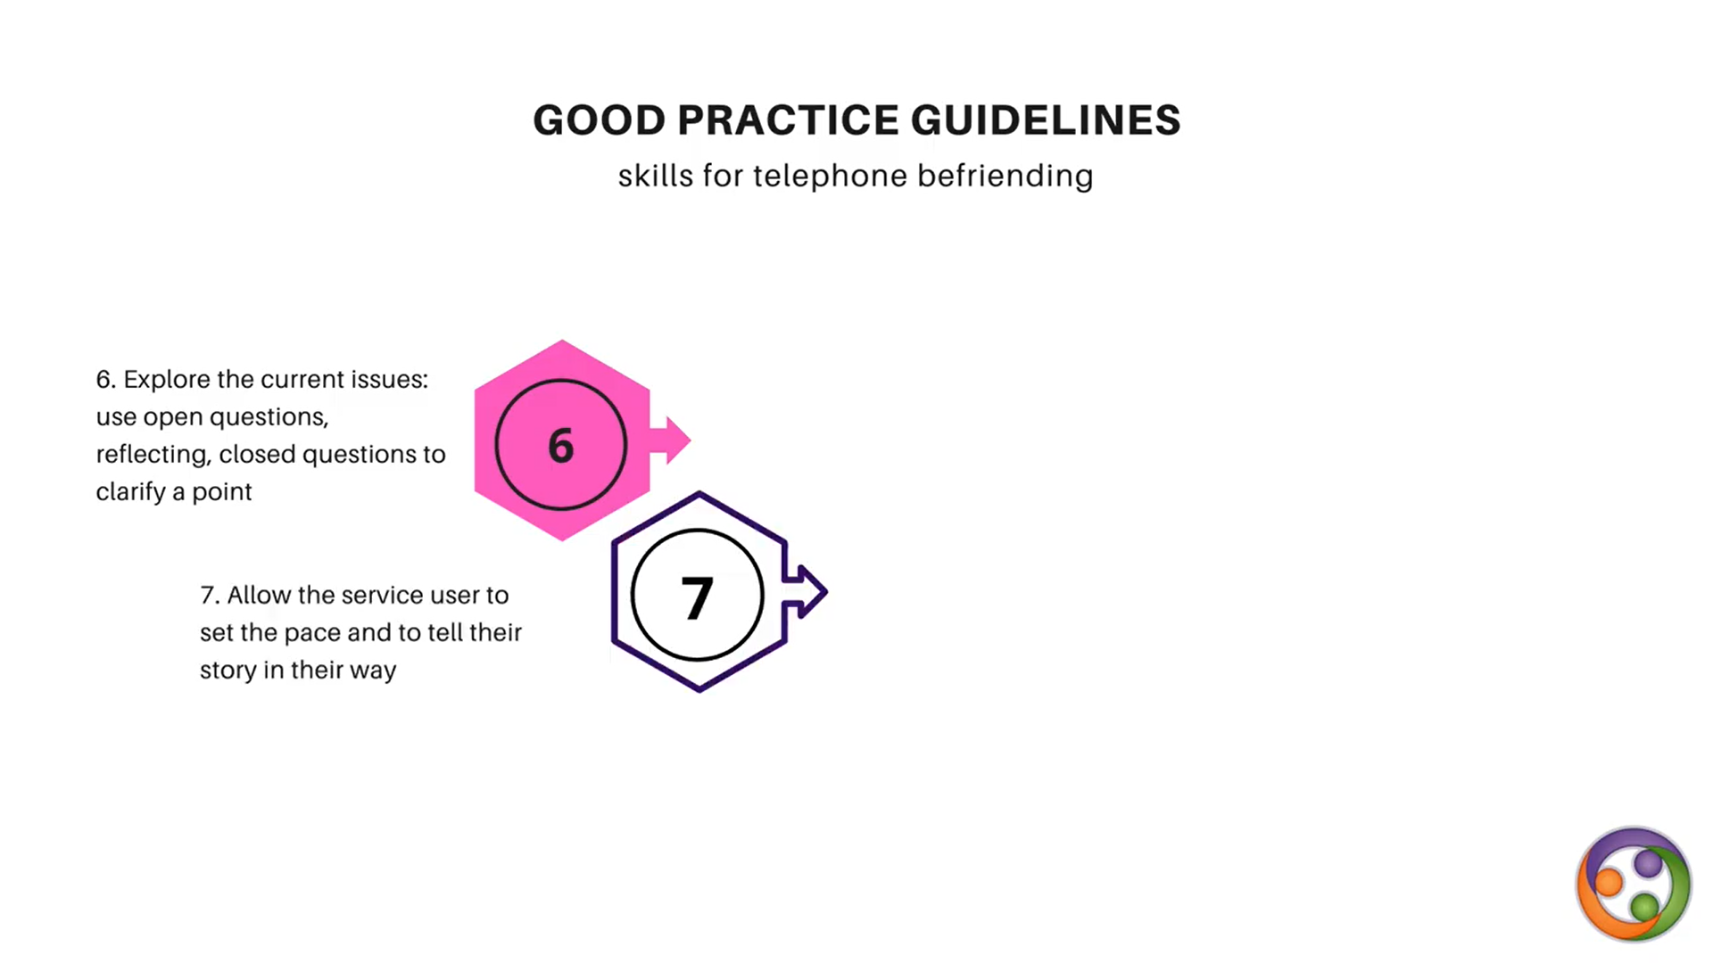
mentoring at a distance
mentoring at a distance
your mentee

Slide 20
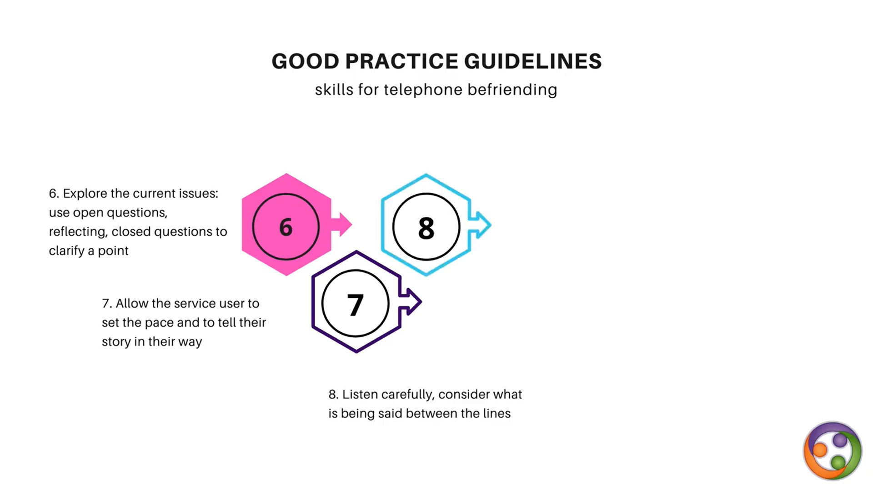
mentoring at a distance
mentoring at a distance
your mentee

Slide 21
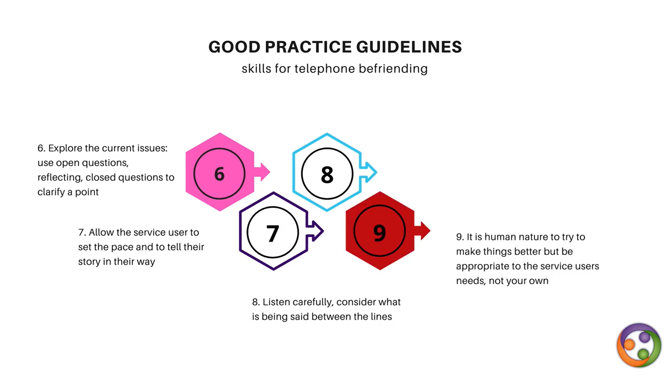
mentoring at a distance
mentoring at a distance
your mentee
your mentee‘s

Slide 22
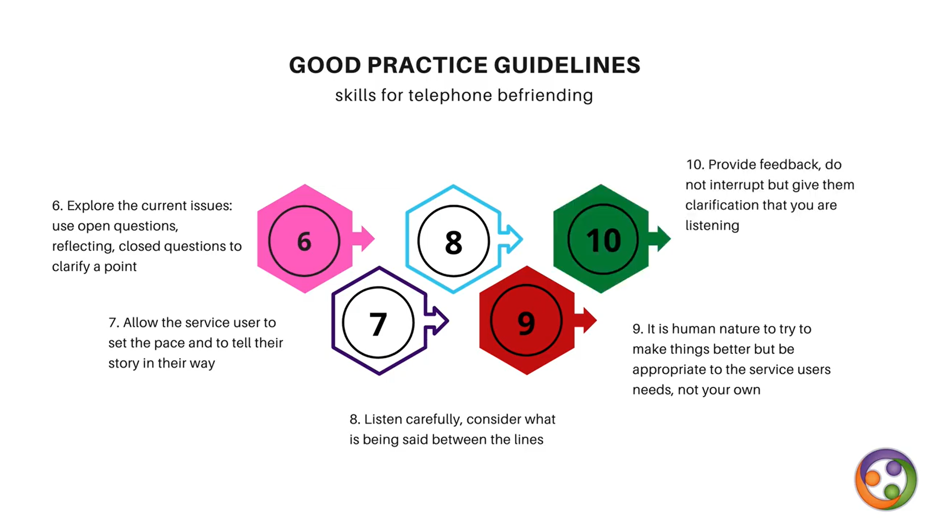
mentoring at a distance
mentoring at a distance
your mentee
your mentee‘s

Slide 23
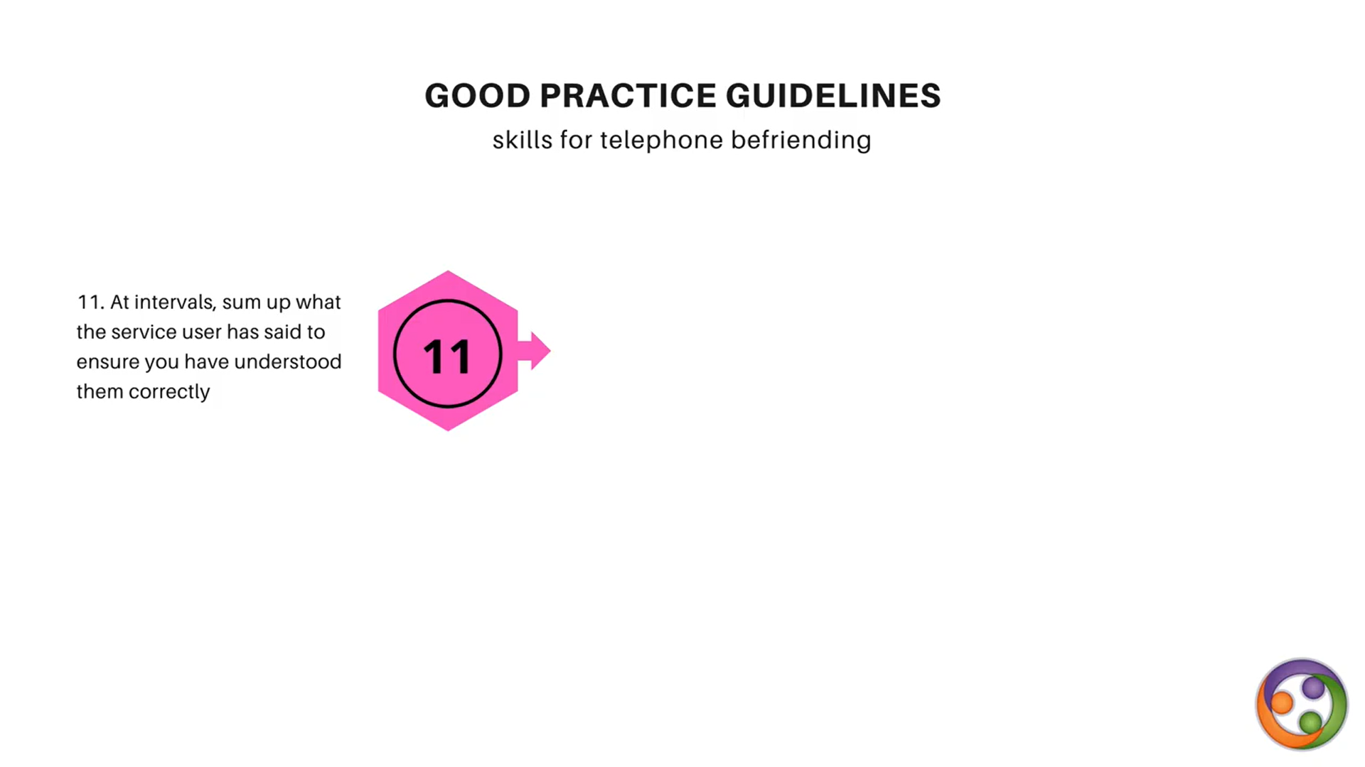
mentoring at a distance
mentoring at a distance
your mentee

Slide 24

mentoring at a distance
your mentee

Slide 25
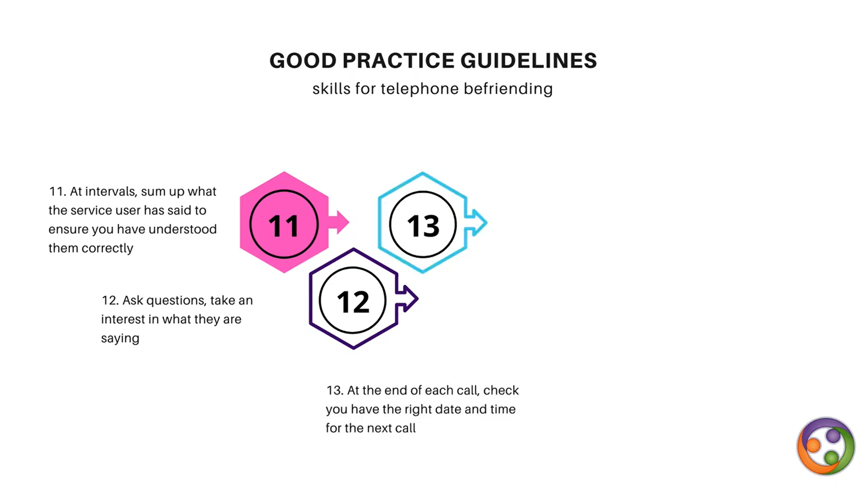
mentoring at a distance
mentoring at a distance
your mentee

Slide 26
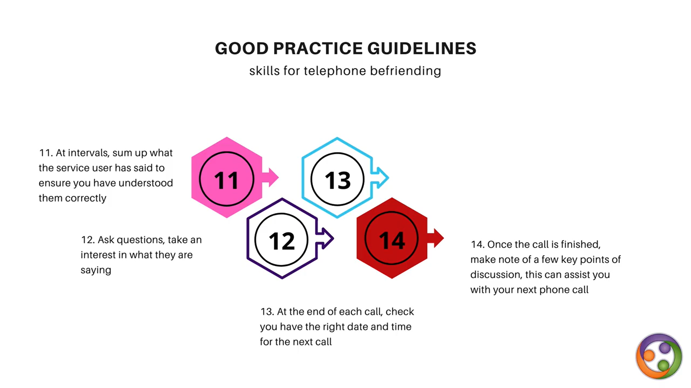
mentoring at a distance
mentoring at a distance
your mentee

Slide 27
REFLECTIVE QUESTIONS II
Do you think active listening is different (easier/harder?) over the phone or on a video call? How?
Where would you make your phone/video calls? Where is your distraction-free space where you can be alone for the duration of the call?
Do you think it’s important to do an activity with your mentee, even over the phone/video? Why?
Can you think of any activities that would work at a distance?

Slide 28
Example game plan for a phone/video call
Prepare in advance and have a plan for the conversation:
Check-in – begin by setting the scene and getting your mentee to do the same:
Where are you in your house? – where is your mentee?
Who’s with you? (no-one) – who’s with your mentee?
What were you doing before you called? – what was your mentee doing?

Slide 29
2. Follow up from any agreed tasks/activities you had agreed last session, e.g. making an origami elephant
Have any materials you need for any planned activity to hand – e.g. some paper
Ask lots of questions – Do like elephants? Have you ever seen one? When, where/would you like to? Favourite animal?
Chat about the activity itself – Are you both finding it easy/hard/fun/boring/complicated? Are you happy with the results? Would you do the activity again or maybe not?
Allow time for general chat – anything new? Favourite tv/film/meal/book since last spoke?

Slide 30
3. Set activity/discussion topic for next call, E.g. playing “Who am I?”
4. Confirm day and time of next contact.
5. Check-out
What is your mentee doing next?
What are you doing next (nothing too exciting!)?
End call/videocall.
TIP: Together with your mentee, keep two lists of activities you can do together/enjoy/would like to do – one for over the phone/call, and another for when you can meet again in person (but set the right expectations – following social distancing rules etc.)

