Slide 1
Portfolio Day

Slide 2
Agenda
9.30-10.00am
10.00-10.15am
10.15-10.20am
10.20-11.45am
11.45am-12.15pm
Coffees and chance to chat
Welcome
Portfolio Progress Update
UNC Rights of the Child and intandem
Importance of Play
All
Celia Tennant, CEO
Maree Todd, Minister for Children & Young People
Julia Abel, Head of Funds
Juliet Harris, Together Scotland
Nathan MacGillivray, Broxburn Family Centre

Slide 3
Agenda
12.15-1.00pm
1.15- 1.45pm
1.45-2.30pm
2.30-2.45pm
2.45-3.15pm
3.15-3.30pm
Lunch
Active Play
intandem Evaluation
Tea
Introduction: Out of Harm Toolkit
Wrap Up of the day
Nathan MacGillivray
Neil Blake, intandem
Wendy Woolfson, Quarriers
Susie White, intandem

Slide 4
Welcome

Slide 5
Portfolio Update

Slide 6
Portfolio Statistics
571 Volunteers recruited
375 Trained Volunteers
318 Referrals received
133 Matches underway
205 Total matches made

Slide 7
Quality of Relationships
Coordinator’s role is key to supporting and sustaining matches
Coordinators work closely with others to support the young person

Slide 8
Volunteer Mentors
On average receive 16 hours of training
Commitment and reliability are key

Slide 9
Young People
“My mentor is my treat of the week.”
“It’s great just to be able to feel like a kid again.”
“Instead of having something heavy on ma shoulders, ah can talk to someone about it.”

Slide 10
UNCRC Rights of the Child – Juliet Harris

Slide 11
Importance of Play – Nathan MacGillivray

Slide 12
Evaluation Recap and Next Steps

Slide 13
The Impacts of intandem
Short-term : child or young person/their family/the community/the mentor
Medium to long term: child or young person moving into adulthood

Slide 14
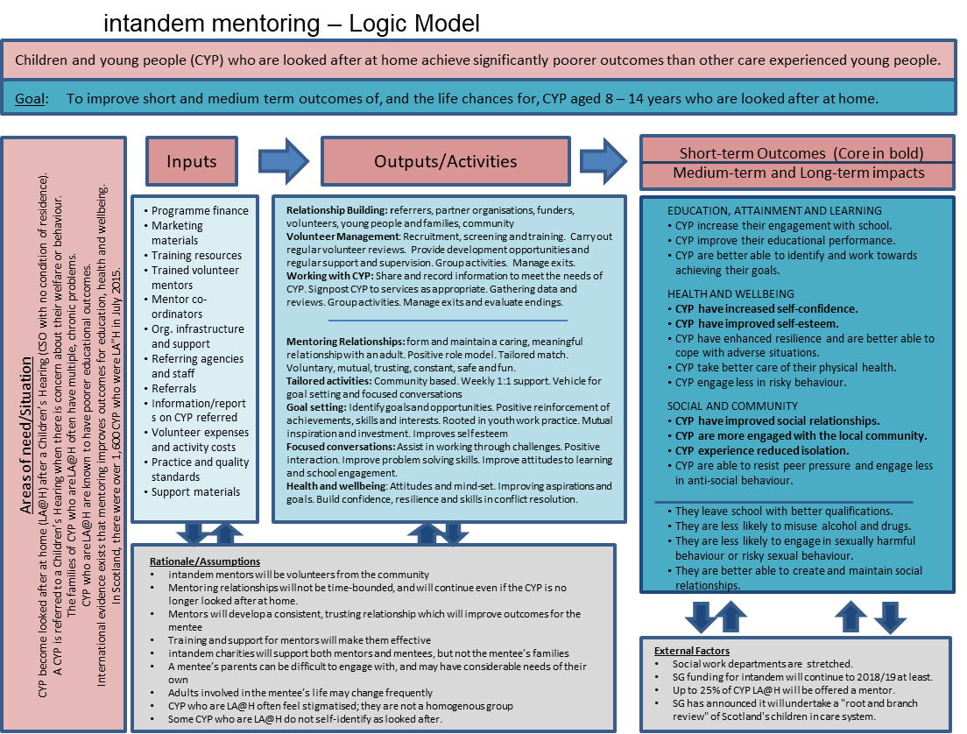
The Impacts of intandem
Improved self-esteem and confidence, doing more in the community, reduced social isolation, improved relationships.
What else have you seen change?
What do you hope will change for the better for your mentees as they grow into adulthood?
Child or
young person

Slide 15
The Impacts of intandem
Mentor
Based on your experience, what impacts have you already seen for each of these groups?
Do you think there will be any long-term impacts? If so, what are they?
Family
Community

Slide 16
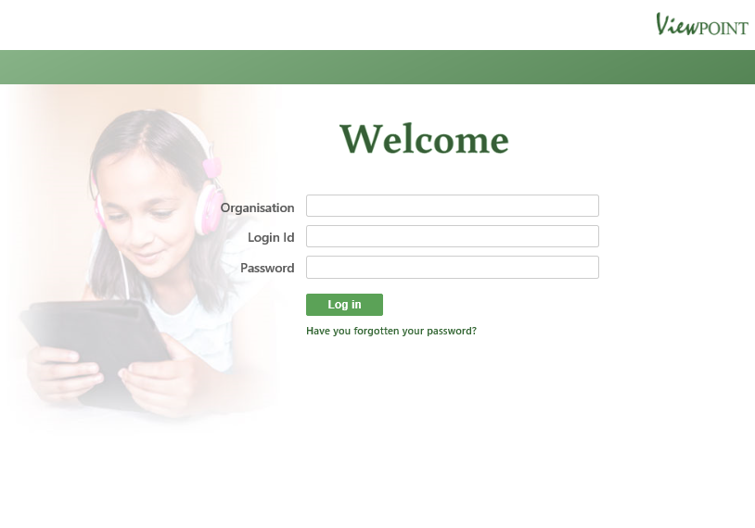
Viewpoint

Slide 17
Viewpoint
It’s how we measure progress against the five core outcomes
We still need to emphasise the importance of collecting the Viewpoint data regularly
Data is being provided on Monday for analysis by the external evaluators
I am available to support with any queries on Viewpoint, and provide training/workshops when needed
We have updated the guidelines for use of Viewpoint, and these are on the intandem website

Slide 18
External Evaluation: Interim Report
What did the Interim Report (Sept 2018) cover?
Feedback from coordinators on set up and implementation
Interviews with mentees and parents
Survey of mentors
Outline of Key Issues

Slide 19
External Evaluation: Interim Report
Early indications suggest that the programme is having a significant impact, with volunteer mentor co-ordinators reporting improved self-confidence, social skills and family relationships amongst their mentees.
Some projects have reported a positive impact on family relationships.
Mentors (96%) were motivated to volunteer by
the desire to help a young person who is disadvantaged. A high number (47%) were also motivated by a general desire to volunteer and to contribute to the local community.
All survey respondents indicated that the training they received very effectively or quite effectively prepared them for becoming a
mentor.
There are a small number of key issues and considerations that have been identified
“It’s like having a funder but having a supervisor as well”

Slide 20
External Evaluation: Final Report
What will the Final Report (Q4 2018/19) cover?
The impact on the young people being mentored, mentors, and families
Key factors which influence the effectiveness of intandem
How intandem compares with other supports
Assessed through:
Further interviews with children and families
Interviews with mentors
Further interviews/consultation with key staff in the portfolio
Analysis of the evaluation data collected

Slide 21
Our evaluation focus will produce
Evidence of the social impacts
Cost benefit illustrations
Core outcomes
Case studies
Quotes
Viewpoint
External evaluation
The Business Case for intandem

Slide 22
Needs and Offers
What’s missing before we can build a comprehensive business case?
Your knowledge of observed impacts on families
Demonstration of the cost benefits of intandem
Educational impacts on the young people being mentored
Additional information on our young people and the matches
What can you offer to provide?

Slide 23
Illustrating the intandem impact on costs
Through detailed case studies, identify the costs of delivering mentoring, and compare this with the costs that you can justify as being avoided

Slide 24
Demonstrating the intandem impact on families
Guided questions leading to
development of case studies
a sense of how many matches generate impact on families

Slide 25
Demonstrating the intandem impact on the young person’s engagement with education
An online questionnaire for you to complete. It identifies how much information you have, or can easily find, leading to
development of case studies
a sense of how many young people have improved attendance (and performance?) at school

Slide 26
Further monitoring information
Five simple questions, to help give a fuller picture of the mentoring matches that have been created:
What is the average length of time of mentoring relationships?
What is the average number of mentoring hours each month for your mentoring matches?
What proportion of your trained and PVG-checked volunteers have progressed to being a mentor?
What percentage of your referrals have come from social work?
What are your other sources of referrals, and what percentage of referrals have they provided?

Slide 27
Needs and Offers
We need:
Your knowledge of observed impacts on families
Demonstration of the cost benefits of intandem
Educational impacts on the young people being mentored
Additional information on our young people and the matches
What can you offer to provide?

Slide 28
Wrap Up - Susie

Slide 29
Things to Take Forward from Today
Embedding a Rights Based Approach
Introducing Play to intandem
Supporting Evaluation
Enhance conversations with the Out of Harm Toolkit

