Slide 1
Celebrating One Year of Mentoring

Slide 2
Message from First Minister

Slide 3
Agenda for morning
10.30am
10.45am
11.00am
11.30am
12.15pm
1.00pm
Welcome and thank you from Inspiring Scotland
Welcome and thank you from Scottish Government
Cake and Photos
Table discussions
Lunch
Visit to the zoo
Afternoon agenda
Celia
Donald

Slide 4
intandem Cake

Slide 5
One Year of Mentoring Thank You
To our young people for giving intandem a go
To our volunteers for their time and commitment
To our coordinators for their work to start and sustain mentoring
To our charities for working with us so positively to build a national programme

Slide 6
Table Discussions

Slide 7
Some questions for you
What kinds of things have you and your mentor done together?
How do you decide what to do?
Have you got plans for things you want to do in the future?
What have you enjoyed the most?
5. What would you like to do again?

Slide 8
Some questions for intandem staff
Discover – successes
What should we appreciate/do more of?
Dream – imagine
What are your aspirations for intandem?
Utopia – ideal
What’s the ideal for intandem and how will it happen?

Slide 9
Lunch

Slide 10
Agenda for the afternoon
1.00pm
1.15pm
1.45pm
2.00pm
2.10pm
2.55pm
Feedback from morning session
Evaluation and consents
Learnings from EU Mentoring Summit
Coffee
How best to capture Voice of Young People
Closing remarks
Neil
Neil
Susie
Susie
Lynn

Slide 11
Feedback from the morning discussion
If you had a wish for the intandem programme, what would it be?
What’s the ideal and how will it happen?
What are we going to do to grow the good?

Slide 12
The intandem programme – the future, and the importance of impact
It is Scotland’s Mentoring Programme for Young People.
To grow the good, evidence of its impact is required.
So, how is your charity getting on recording impact?
Notes:
Emphasise Scotland and Young People, and draw out how far the current implementation is from delivering against this aspiration
SG has indicated its desire to grow the mentoring programme, and needs to consider whether the programme is delivering impact as expected. If so, SG has to decide in which direction to grow intandem (geography/age range/target population).
Whichever direction, SG needs to see the impact. SO: how are you getting on with capturing impact information on Viewpoint.
Exercise:
Separately, vol co-ordinators and service managers to write down:
How many live matches are there?
How many have baselilne data recorded for them?
How many have their three monthly data collections full up to date.

Slide 13
The intandem programme – how is your charity getting on with impact recording?
How many live matches have you got?
Has baseline data been captured for all of these young people?
Are the three monthly impact reviews up to date for all of these young people?
Is your data on Viewpoint up to date? Have you got a diary?
Notes:
Exercise:
Separately, vol co-ordinators and service managers write down and then compare:
How many live matches are there?
How many have baselilne data recorded for them?
How many have their three monthly data collections full up to date.
The message here is that we are asking the service managers to take an active role in making sure that evaluation data is being recorded on time.
We need the impact recording to be accurate and complete.

Slide 14
Keeping track of data for evaluation:
Mentee | Kirsty | Kyla | Jamie C | Jenny F | Patrick McI
Mentor | Helen | Brenda | Fiona | Helen | John
Date of 1st meeting | 04/09/2017 | 11/09/2017 | 18/09/2017 | 12/11/2017 | 25/03/2018
Date baseline data due | 02/10/2017 | 09/10/2017 | 16/10/2017 | 10/12/2017 | 22/04/2018
Date baseline data collected | 03/10/2017 | ! | 23/10/2017 | !
1st 3 monthly self-assessment due | 01/01/2018 | 08/01/2018 | 15/01/2018 | 11/03/2018
1st 3 monthly self-assessment collected | 15/01/2018 | ! | 31/01/2018 | !
2nd 3 monthly self-assessment due | 02/04/2018 | 09/04/2018 | 16/04/2018
2nd 3 monthly self-assessment collected | !
3rd 3 monthly self-assessment due
3rd 3 monthly self-assessment collected
4th 3 monthly self-assessment due
4th 3 monthly self-assessment collected
5th 3 monthly self-assessment due
5th 3 monthly self-assessment collected
6th 3 monthly self-assessment due
6th 3 monthly self-assessment collected
Notes:
Exercise:
Separately, vol co-ordinators and service managers write down and then compare:
How many live matches are there?
How many have baselilne data recorded for them?
How many have their three monthly data collections full up to date.
The message here is that we are asking the service managers to take an active role in making sure that evaluation data is being recorded on time.
We need the impact recording to be accurate and complete.

Slide 15
Evaluation – quantitative data plus case studies
73% of young people showed an improvement of two or more points in self-confidence in the first nine months.
“Rob is 12 and lives in Bathgate in West Lothian. In his young life, he has experienced 11 different homes and 7 different schools. Before he met his mentor, he was scared to leave his house. Now he attends school most days and plays football after school….”
Notes:
“Rob is 12 and now lives in Bathgate in West Lothian. In his young life, he has experienced 11 different homes and 7 different schools.
“He witnessed domestic abuse from his mum’s previous partner and was also exposed to neglect and alcohol abuse which affected his self-esteem and coping strategies. He lived with his gran for over 8 months when in Fife but his grandmother died in November 2016 (Rob found her dead.)
“Rob was found a mentor, and he chose to focus his goals on helping more in the house and be kind to people at home as an early goal. He then focused on trying new activities and pushing himself out of his comfort zone. He then said he wanted to try stay out of trouble in the community. Most recently he wanted to make new friends and get fitter. All of which he has achieved to date.
“His mentor says “he is like a different boy; his body language has changed and he sits up straighter and stands tall, makes eye contact with me and strangers in cafes and shops where before he would have his head down and shoulders slumped. He is much more confident and openly starts conversations, engages with members of the public and communicates well”.
So, how did you feel when you heard this story?
What did it add?

Slide 16
Evaluation – case studies
Case studies add an enormous amount of “life” to the impact data.
Everyone loves stories, and these stories really help people understand the impact of mentoring.
We want an update to your case studies every quarter – or for them to be completed and a new one started.
Notes:
Again, emphasise the role of the service manager in this.

Slide 17
Keeping track of case study progress:
About | Started | Progress | Finish date? | Finished
Helen, mentor | 17/01/2018 | Helen settling into her role as mentor and has identified growing confidence. Should finish case study when some information available on progress of Liam, her mentee. | 30/06/2018
Jamie, mentee | 25/02/2018 | Drafted background to his referral and his first steps in building a relationship. Case study will be complete when we can see progress on his objectives, and we have quotes from his mother and social worker. | 31/07/2018
Notes:
Exercise:
Separately, vol co-ordinators and service managers write down and then compare:
How many live matches are there?
How many have baselilne data recorded for them?
How many have their three monthly data collections full up to date.
The message here is that we are asking the service managers to take an active role in making sure that evaluation data is being recorded on time.
We need the impact recording to be accurate and complete.

Slide 18
Blake Stevenson – external evaluators
Scoping visits/interviews: by Dec 2017
Interviews with young people and parents/guardians: March/April and Oct 2018
Desk research on comparative approaches: Jun to Oct 2018
Surveys with volunteer co-ordinators: July 2018; and interviews with volunteer co-ordinators: Aug to Oct 2018.
Interviews with mentors: Aug to Oct 2018
Notes:
Check how many children/parents
Informed consent will be collected by Blake Stevenson in advance of interviews with young people and parents/guardians.
Please give Blake Stevenson as much support as you possibly can.

Slide 19
Evaluating Impact on Education
High profile topic
Three primary factors: attendance, exclusions and performance
Scottish Government collect statistics centrally
Notes:
Check how many children/parents
Informed consent will be collected by Blake Stevenson in advance of interviews with young people and parents/guardians.
Please give Blake Stevenson as much support as you possibly can.

Slide 20
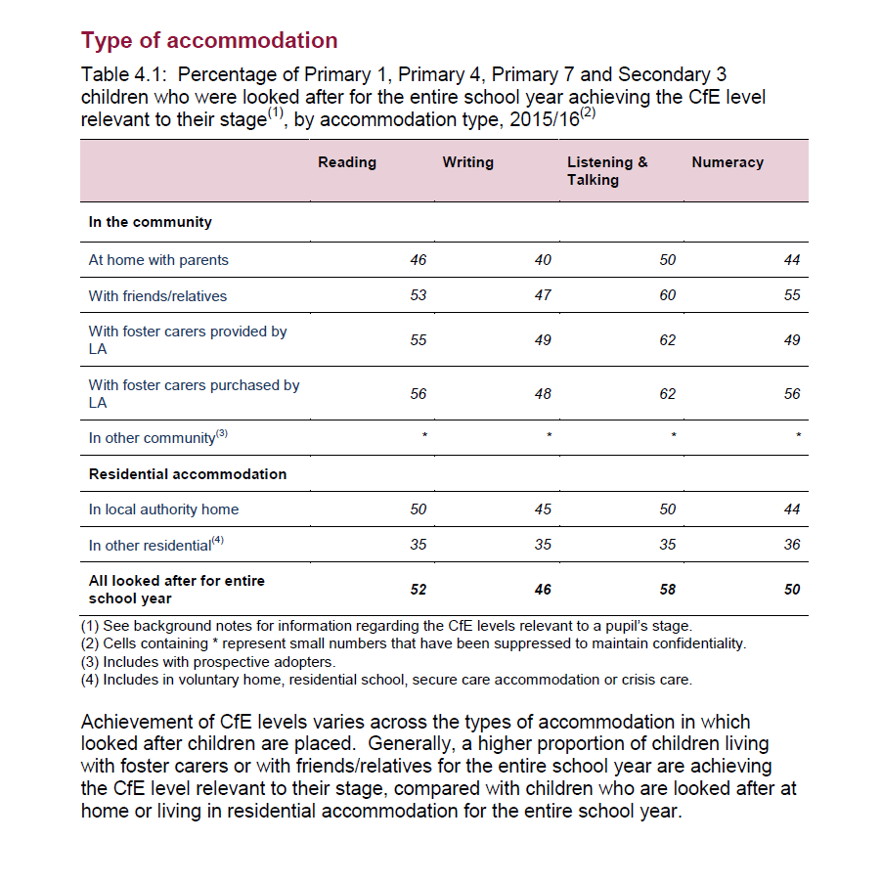
Notes:
Check how many children/parents
Informed consent will be collected by Blake Stevenson in advance of interviews with young people and parents/guardians.
Please give Blake Stevenson as much support as you possibly can.

Slide 21
Evaluating Impact on Education – Scottish Government Statistics
Analysis available: using the SCN of intandem mentees to compare against the total population or all care experienced children
What are the options for intandem? (Note: SCN is available via social work – you don’t need to go to the young person’s school to get it.)
Notes:
Check how many children/parents
Informed consent will be collected by Blake Stevenson in advance of interviews with young people and parents/guardians.
Please give Blake Stevenson as much support as you possibly can.

Slide 22
Scottish Government – Attainment Gap and PEF
Inspiring Scotland has invited SG to present on the approach to tackling the poverty-related attainment gap and how the voluntary sector can support this policy area.
Any questions - ideally related to our core group that we are interested in (care experienced children and young people) on attainment and/or the PEF?
Notes:
Check how many children/parents
Informed consent will be collected by Blake Stevenson in advance of interviews with young people and parents/guardians.
Please give Blake Stevenson as much support as you possibly can.

Slide 23
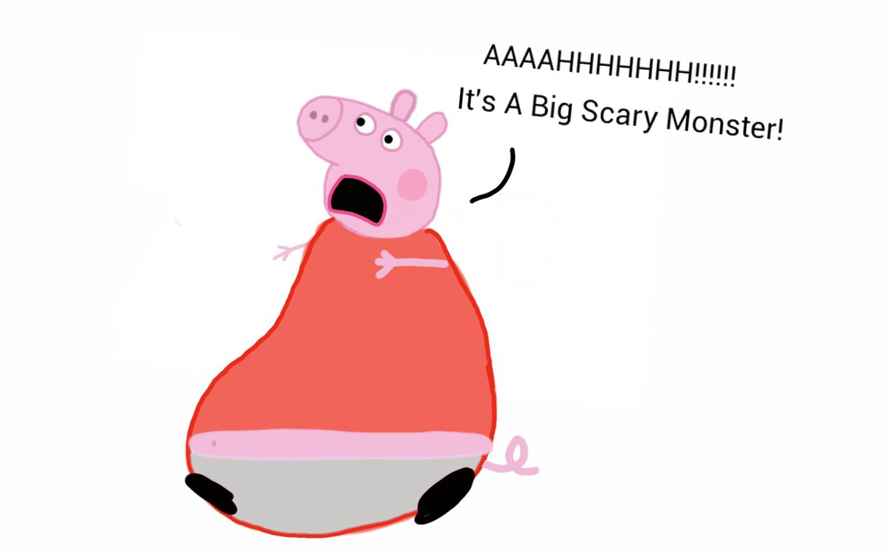
GDPR: presented at the Training Day in November
not

Slide 24
GDPR: five steps to achieving compliance
1
Awareness in the organisation
2
Knowing what data you hold & process – and why
3
Permission to hold & process personal data - consents
4
Understanding the individual’s rights
5
Organisational changes

Slide 25
Evaluation and consents
Recording of data on Viewpoint must be covered in your consent form, especially that the data is shared with “the managers of the intandem programme”
Age of consents: is Viewpoint an ISS (age of consent 13) or not (age of consent in Scotland 12)?
Case studies – if your consent form does not give you permission, you either need a specific consent for this, or you need to anonymise the information

Slide 26
Reflections on EU Mentoring Summit

Slide 27
Five Main Learnings
Mentoring does not always work
Volunteers are a scarce resource
Training is crucial – realistic expectations for everyone
The relationship alone is not the intervention
5. Relationship quality indicates duration and impact

Slide 28
For Mentoring to Work
Research shows impact is small unless:
Right elements are in place http://www.mentoring.org/program-resources/elements-of-effective-practice-for-mentoring/
Mentors are skilled and trained - not for everyone
Clear goals and practice space
A relationship which fails early is worse than none at all
Notes:
Academic research is not all positive – not all mentoring programs have a big impact, and programs with certain elements have a greater degree of success (duration of match and impact). Recommend you all look at Elements of Effective Practice for Mentoring, even just the checklist.
Research shows that a relationship which fails early is worse than no relationship at all - so volunteers need to be carefully selected, trained and supported to maintain a match and identifying the right match is key. An unplanned ending can make a young person less likely to reach out for help from an adult – hence quality not quantity.

Slide 29
Volunteers
Scarce resource so use them wisely
‘Caring’ background
Committed
Paraprofessional
Notes:
Volunteers, especially volunteer mentors are not increasing in numbers, numbers have stayed flat over past 10 years (ncvo around 18% of volunteers are befriending/mentoring). Some studies have shown that for young people with signs of risk or risky behaviour, mentors with a background in ‘helping’ are more likely to have a bigger impact. Risk of early unplanned ending is greater with those showing signs of risk – can be 40% or even higher ‘failure’ rate.
In intandem we have unplanned endings running at between 14% and 63% (a simple calculation of unplanned endings over live matches so perhaps not best data as any delayed rematches will make this percentage worse). But important that each of you understand this rate for your intandem matches and also seek to understand if there is anything driving it higher than could be expected – we know stuff happens, people move, people have babies, but how predictable/expected are these events and what is in your volunteer contract around continuing until a match has been through a planned ending? Some charities ask volunteers to commit to a month’s notice in their volunteer agreement so the last four meetings can be used for a planned ending and celebration/or handover. Likewise, screening and selecting the right volunteers by peppering the conversations at training with ‘not everyone who is here will be chosen as a mentor’ or ‘the number of mentors will depend on the number of referrals we receive/our capacity etc’ to be clear that this is a selection process and manage their expectations.
Likewise how does the impact of an unplanned ending this inform your matching process, and on going contact/supervision of volunteers and young people/families?

Slide 30
Training
A high degree of training
Sense of self-efficacy
= Increased match duration
Notes:
Mentors with a high degree of training and a sense of self-efficacy in mentors reduce the risk of relationships ending early and in an unplanned way. Self-efficacy is a feeling that you can succeed in specific situations or tasks and feeling competent is increased by training and practice so are your volunteers getting enough opportunity to develop self efficacy?
Many of you will have based your training on both experience and the quality standards from Scottish Mentoring Networks and Befriending Networks. Additionally, there is the Elements of Effective Practice for Mentoring, free to download and lists the key elements shown by research to result in greater impact. The Authors were at summit: although two hours of training is minimum they stress you can’t possibly cover what they consider the minimum requirements within a two hour slot.
In the intandem portfolio, training hours for volunteers range from 10-24 hours. There is strong research evidence that mentor training has implications for match length and the mentor/mentees perceptions of the quality of the relationship – which in turn has implications for positive outcomes and the continuation of the relationship. (see Elements under justification for training). A mix of online and face to face training has been shown to have most impact on efficacy and expectations– do you make use of any online resources to support mentors training, and enhance their understanding?
We also should understand the benefit to the community of these trained volunteers. At the moment our impact measurement rightly is centred on young people but there is likely a considerable wider benefit which we are not currently measuring, but which may leave communities better connected and/or better equipped to deal with challenges.

Slide 31
Clear goals and practice
Relationship is the context for the intervention
Chance to practice skills
Notes:
Clear goals and practice: it’s not enough to have the relationship alone as the intervention, you need to be working on something to change dynamics or behaviours. A friendship model alone will not produce reliable, significant impact – it takes more than a close enduring bond, although these can be hugely influential for the individual. If the relationship is the context for intervention and provides the space to help practice and master skills, it can provide much greater impact and change. One of these skills is the mentees ability to ask/seek help which builds resilience.
How does this inform our goal setting – do we identify specific skills which are practised within the relationship, such as asking for help, or trying new situations/experiences?

Slide 32
Realistic Expectations
Training not just for volunteers
What is a mentor
What a mentor is not
Communication expectations
Notes:
Realistic expectations: A relationship that does not live up to expectations can do more harm than good, making a young person less likely to reach out to an adult for help. Providing training for mentees and parents/guardians as well as mentors has been shown to help everyone have realistic expectations for the relationship. If programmes offer specialised training to mentors, they have longer and stronger matches.
How do we ‘train’ families and young people – do our individual intandem leaflets and family visits cover enough to get the benefit of realistic expectations? Exercises such as what a mentor is and what a mentor is not help to clear set expectations; likewise do some families have unrealistic expectations?
Training tips from workshop included exercise in roles – what a mentor is/what a mentor is not; primary roles and tasks of a mentor – covering the idea of a mentor as a friend, a positive role model and a RESOURCE BROKER, so helping mentee access opportunities/try new things/develop interests/reach goals, understanding guardian/parent roles and responsibilities (for example helping child to communicate with mentor; how guardian can support relationship by having child ready/contacting co-ordinator if they have any questions, respond to emails/call from co-Ordinator within 24 hours or similar). Likewise for young person, understanding the program itself, practicalities of how far in advance should they make plans, what are their expectations of the match, what if you feel you don’t have anything in common?

Slide 33
Quality of Relationships
Quality is most important factor in match duration
How do we think about quality
Co-ordinator is key
Notes:
Quality of relationships: The quality of the relationship is most important factor in whether match will last and whether a mentor will stay on and encourage others.
Quality is affected by expectations, by the ‘right’ match, by appropriate training, by on going supervision/support and the framework around the mentor/mentee relationship.
The coordinator’s support and skill are vital – and can improve the quality of relationships for matches. So how are you assessing the quality of the relationship (do you instantly pick up when communication or even frequency of meetings is starting to go? Do you understand what elements make a specific mentor or young person assess the relationship as strong – what is it that they need to feel things are going well and how do they let you know this.
What are the danger signs in your experience; what are the things that make you go yay! That’s a great match.

Slide 34
Voice of Young People

Slide 35
Voice of Young People
Two aspects
Continuing to involve Young People in building intandem (locally and/or nationally)
Ensuring the voice of Looked After at Home Young People is heard and passed on
Notes:
We have already involved young people in the design of intandem, in the branding and the evaluation workshops; and I am sure your organisations will have a variety of ways to engage with young people, perhaps through regular or ad hoc groups or more formal forums, or just gathering views as part of your standard practice.
I want to focus on two specific aspects to what I’m calling the voice of young people – first how do we involve young people in intandem’s development and decision making - not just as a way of improving the mentoring service which I am sure your organisation’s already do, but actually in the decision making process so they are empowered and contribute to the future of intandem.
Secondly, is how do we ensure that this group of young people are heard and represented, that their views and ideas are put forward and considered when decisions affecting them are made?
This might be to do with policy or practicalities, for example how do we engage with the care review, with corporate parents, the Champions Boards; should we communicate with corporate parents on what we have learnt, I’m sure you have plenty of ideas.
Y sort It’s experience of involving young people and providing a way of amplifying their voice has been through the creation of a young people’s forum. Gillian’s on holiday today but she would be the first to say this has at times been a challenge but has lead to new ideas and ways of working which have enhanced Ysort IT as an organisation. In your tables, please share your experiences and thoughts on how young people can be encouraged to co-create intandem.

Slide 36
Discussion 1
How do we involve young people in intandem? 20 mins
YOYP2018 – co-creating and co-designing
Locally
Nationally
What’s been your experience of what works?
What’s already in place?

Slide 37
Discussion Ground Rules
Openness
Aspiration
Respect
Commitment

Slide 38
Discussion 2
How do we ensure the voice of intandem young people is heard? 20 mins
Who/Where
When
What
How
Notes:
Aim of this discussion session is to get your views on how we ensure the voice intandem young people, of looked after at home young people, is heard – who by and how is a represented - or is it covered already, can we represent it, where do we need to get involved or lend support? Do our intandem young people need a voice? if we don’t do this, who does? who to connect with – care review; champions boards, corporate parents
How is this best done? We’ll have 15 mins on this and then I’ll ask each table to spend 5 mins summarising their thoughts.

Slide 39
Fish Bowl Discussion Ground Rules
Inner circle discuss
Outer circle listen
Take a seat or tap shoulder to join inner circle
Always an empty chair
PAs to Note key points

Slide 40
Close
Notes:
Thanks for participation today – thanks to our guests. Actions to take forward. Use Viewpoint and continue to feedback, consider what you will share with your mentors on ACE’s and keep sharing ideas and solutions – remember you have the website discussion boards to help.

Slide 41
Portfolio Statistics
357 Volunteers
236 Trained Volunteers
201 Referrals received
101 Matches underway
Notes:
Based on your March quarterly reports, we are thrilled to say we have over 100 active matches meeting. Momentum is now building and many of you have started to see referrals numbers increase this quarter which, after family visits and identifying the right matches, will hopefully turn in to more live matches next quarter.

