Slide 1
Information Session March 2nd 2017

Slide 2
Brief Glossary
PVG – The Protection of Vulnerable Groups (Scotland) Act 2007 and the resulting disclosure checks and scheme memberships.
Barred/Barring/Listed/Listing – being deemed unsuitable to undertake regulated work.
Consideration for Listing – not a full barring but where there is information that is being further investigated to determine suitability to undertake regulated work.
Lists – there are two lists of people who are deemed unsuitable to do regulated work. You can be placed on the children's, protected adults or both lists.
Referral – an organisations legal obligation to refer inappropriate behaviour to the
Protection Unit at Disclosure Scotland.
Regulated Work – work related to children and/or protected adults that may bring an individual into the remit of PVG.

Slide 3
Background
Background
PVG established a membership scheme for people doing regulated work with children and/or protected adults in Scotland
Membership is managed by Disclosure Scotland
On 28th February 2011, the PVG Scheme went live and had 0 members
At the end of February 2017 the scheme has
1,041,206 members

Slide 4
PVG Scheme principles
Ensure that those who have
regular contact with vulnerable groups through the workplace
do not have a history of harmful behaviour.
is quicker and easier to use, reducing the need for PVG scheme members to complete a full detailed application form every time a disclosure check is required.
strikes a balance between proportionate protection and robust regulation and make it easier for employers to determine who they should check to protect their client group.

Slide 5
PVG is only 1 part of safe recruitment
Self-
declaration
of
convictions
PVG
Previous
knowledge
Application form
ID check
References
Interview

Slide 6
Who can join PVG Scheme?
Any individual
doing or in anticipation of doing
regulated work (paid or unpaid)
in Scotland
with children and/or protected adults
Note
Also covers individuals who do not live in Scotland but who are undertaking regulated work in Scotland.

Slide 7
Definition of regulated workRegul
Regulated work
Regulated work with children and/or
Regulated work with protected adults.
Individuals can apply to join either the child, protected adult or both regulated work forces, depending on the work they are doing / will be doing.

Slide 8
Normal duties
Normal duties can be considered as something the individual might be expected to do as part of their post on an on going basis, for example appearing in a job description.
Normal duties exclude one-off occurrences and unforeseeable events.
No particular frequency for undertaking the work or duration of work are specified in the Act as these will depend on the context.

Slide 9
Incidental
An important consideration is the degree to which it could be reasonably foreseen that children or protected adults would attend.
Whether an activity is incidental or not is not so much about the numbers of children or protected adults attending but the purpose and intended client group for the activity.

Slide 10
Regulated work with children
In the PVG legislation,
a child is a person under 18 years of age

Slide 11
Regulated work with protected adults
A protected adult is someone aged 16 or over who is in receipt of certain services.
There are four categories of service, receipt of which makes an individual a protected adult.
Care Services.
Health services.
Community care services.
Welfare services.
Notes:
11
11
Flipcharts will be placed around the room with each of the headings detailed above, ask delegates to move around the room and detail what they think each of the above would be, this will generate discussion and give the trainer an insight into individuals interpretation of these services, once this exercise has been complete issue delegates with regulated work (protected adults) flowcharts and review & confirm what each of the above are. This information will be issued to trainers in advance of the session.

Slide 12
Regulated work criteria
A position whose normal duties include carrying out particular activities.
A position whose normal duties include work in a particular establishment.
Particular positions.
A position whose normal duties include the day to day supervision of an individual doing regulated work.

Slide 13
Scenario
Susie is going to be delivering Intandem services to a four different children.
She will be providing support, advice and guidance on a regular basis.
Does Susie require a PVG check?

Slide 14
Scenario
Susie is going to be delivering Intandem services to a child aged 12.
She will be providing support, advice and guidance on a regular basis and this will be undertaken at the home address of the child.
Does Susie require a PVG check?

Slide 15
Scenario
Susie is going to be delivering Intandem services to a child aged 12.
She will be providing support, advice and guidance on a regular basis and this will be undertaken at the home address of the child.
This child is living at home with two parents who are classed as being protected adults. Susie regularly has contact with them when she is visiting the home
What PVG lists should Susie be checked against?

Slide 16
Release of vetting information
The information released on a disclosure certificate changed in September 2015 and was further amended in February 2016,
There is a list of offences which must always be disclosed
There is a list of offences which are to be disclosed subject to rules
Other offences outwith these lists are disclosed under the Rehabilitation of Offenders Act.

Slide 17
Release of vetting information
Some of the rehabilitation periods set out in the Rehabilitation of Offenders Act,
Sentence/disposal | Rehabilitation period for adults (18 or over at conviction date) | Rehabilitation period for young people (under 18 at conviction date)
Imprisonment or detention in a young offender institution for over 30 months (2 ½ years) | Never spent | Never spent
Imprisonment or detention in a young offender institution over 6 months but not exceeding 30 months (2 ½ years) | 10 years | 5 years
Imprisonment up to 6 months | 7 years | 3 years 6 months
Fine | 5 years | 2 years 6 months
Community Sentence | 5 years | 2 years 6 months
Conditional discharge | The period of the order, or a minimum of 12 months (whichever is longer) | The period of the order, or a minimum of 12 months (whichever is longer)

Slide 18
Release of vetting information
All disclosure information is considered up to date upon completion of the relevant checks
Vetting information updates will only be passed to an organisation if the updates either places the individual on the barred list or moves them to being placed under consideration for listing.

Slide 19
PVG SCHEME RECORD
REGISTERED BODY COPY
Disclosure Number: 000000000000000001
MISS JENNY RATED Date of Issue: 18/02/2017
VSDS Page 1 of 1
STIRLING
FK8 1QZ A copy of this disclosure has also been sent to
MR SAM PELL
Applicant Personal Details 24 MADEUP DRIVE
Surname: PELL EDINBURGH
Forename(s): SAM GRAHAM EH7 1AA
Date of Birth: 29/04/1978
PVG Membership No. 1702 1878 9098 6543
Appointment Details
Position Applied For: BEFRIENDER
Name of Organisation: INSPIRING SCOTLAND
Countersignature Details
Registered Body: VOLUNTEER SCOTLAND DISCLOSURE SERVICES (VSDS)
Registered Person: MISS JENNY RATED
Statement of Scheme Membership
Membership Status
The applicant is a PVG scheme member in respect of regulated work with children and, therefore, not barred from that type of regulated work.
Consideration Status
The applicant is not under consideration for listing by the Scottish Ministers for the workforce(s) to which this disclosure relates.

Slide 20
Vetting Information
Convictions and Alternatives to Prosecution
Date Court/Children’s Hearing Offence Disposal
26/06/2010 GLASGOW ROAD TRAFFIC ACT 1988 SECTION 103(1)(B) CHG(S) 1 IMPRISONMENT
SHERIFF ROAD TRAFFIC ACT 1988 SECTION 143 (1) & (2) 5 MONTHS TO DATE FROM
19/06/2010, DISQUALIFIED
LIFE, LICENCE ENDORSED.
CHG(S) 2 ADMONISHED
LICENCE ENDORSED.
CHG(S) 1-2 APPEAL LODGED
30/07/2010, THEN APPEAL
DISMISSED ON 11/03/2011
Cautions
The applicant has no cautions for disclosure.
Prescribed Court Orders & Sex Offenders Notification Requirements
The applicant has no prescribed court orders or sex offender notification requirements for disclosure.
Other Relevant Information
The applicant has no Other Relevant Information for disclosure.
END OF DISCLOSURE
Notes:
103 Obtaining licence, or driving, while disqualified.
(1)A person is guilty of an offence if, while disqualified for holding or obtaining a licence, he—
(a)obtains a licence, or (b)drives a motor vehicle on a road
143 Users of motor vehicles to be insured or secured against third-party risks.
(1)Subject to the provisions of this Part of this Act—
(a)a person must not use a motor vehicle on a road [F1or other public place] unless there is in force in relation to the use of the vehicle by that person such a policy of insurance or such a security in respect of third party risks as complies with the requirements of this Part of this Act, and
(b)a person must not cause or permit any other person to use a motor vehicle on a road [F2or other public place] unless there is in force in relation to the use of the vehicle by that other person such a policy of insurance or such a security in respect of third party risks as complies with the requirements of this Part of this Act.
(2)If a person acts in contravention of subsection (1) above he is guilty of an offence.

Slide 21
The lists

Slide 22
On-going regular disclosure checks
The PVG Scheme:
Does not prohibit them
Reduces the need for them
Does not remove the need for them entirely
Now may be a good time to review your policy on regular disclosure checking
How often?
Who manages it?
Do you have a process for self-disclosure?
What new information will you act on?

Slide 23
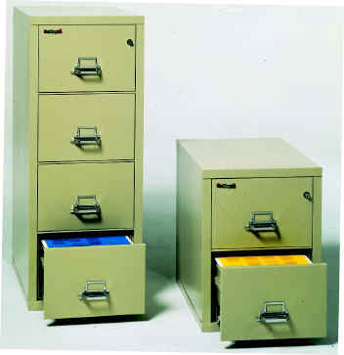
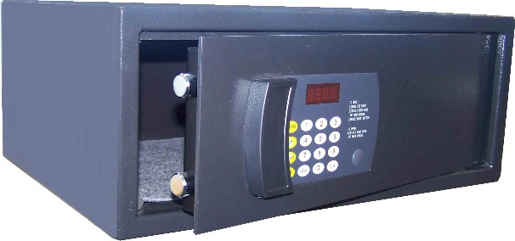
Storage of disclosure information
In secure conditions
Lockable and non-portable storage units.
Keys and/or combinations controlled
Not retained in personnel files.
Notes:
23

Slide 24
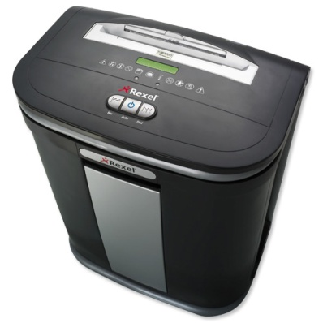
Disposal of disclosure information
The destruction should be by suitable secure means
shredding, pulping or burning
It should not be kept in any insecure receptacle, such as a waste bin or confidential waste sack, whilst awaiting destruction.
No photocopy or other image of the disclosure information may be retained.
Notes:
24

Slide 25
Tracking Systems
We recommend that you keep a record of the following:
Name of applicant.
Position applied for.
Level of disclosure
Unique reference number on form.
Date sent to Volunteer Scotland Disclosure Services.
Date certificate received back and date of disclosure
PVG membership number / Certificate number

Slide 26
Services Offered by VSDS
Training
Online
In person at our office in Stirling
At a location chosen by you
Support
Form filling, enrolment
Advice
Guidance
Best Practice

Slide 27
Any Questions
Telephone – 01786 849777
Email – disclosures@volunteerscotland.org.uk
Web – http://www.volunteerscotland.net/disclosure-services

