Slide 1
Information Session May 2017
Notes:
Give background to reasons for session. Explain relationship between DS and VSDS.

Slide 2
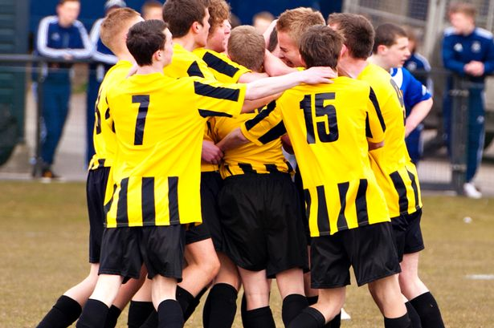
The lists
The PVG legislation created 2 lists of unsuitable people,
one for working with children
one for working with protected adults.
Notes:
Children – coaches, first aiders
Adults – first aiders only
Periphary roles may not be regulated work, & we are in discussions with SYFA about eligibility. Any doubt phone VSDS for advice.

Slide 3
The lists
Notes:
Barring is UK-wide and those barred elsewhere in UK also barred in Scotland.

Slide 4
The lists
For anyone barred from regulated work, it is an OFFENCE to
apply for
agree to do
carry out
regulated work with the relevant group
For organisations, it is an OFFENCE to
Offer regulated work to someone who is on the list
Allow someone who is on the list to continue to do regulated work with the relevant group
Fail to make a referral to Disclosure Scotland within 3 months when the grounds are met

Slide 5
Conditions for making a referral
The person is permanently
DISMISSED
OR
REMOVED
from regulated work
the
GROUNDS
have been met
And

Slide 6
Conditions for making a referral
But what if they’ve already left?
What if you don’t find out about inappropriate conduct until after they’ve gone?
You must still refer

Slide 7
Make a referral
ONLY and ALWAYS when the 2 conditions apply.
Even if referring to other agencies (Police, SSSC, Care Inspectorate) a referral MUST still be made
Even if it is not a police matter or the police decide not to take any further action.
Refer within 3 months of the grounds for referral being met.

Slide 8
The “grounds”
that the individual has, whether or not in the course of the individual’s work (paid or voluntary) -
Caused harm
Placed someone at risk of harm
Engaged in inappropriate conduct involving pornography
Engaged in inappropriate sexual conduct
Given inappropriate medical treatment

Slide 9
PVG examples of inappropriate behaviour
Sexual abuse, physical assault, supplying illegal or unauthorised drugs
Emotional abuse
Coercing someone to harm themselves or to harm others
Neglecting a person’s needs
Inappropriate physical restraint
Failing to attend to whatever health & safety requirements may be in force
Using inappropriate language

Slide 10
The Referral Process
Intandem submit a referral to the barring lists form.
The Protection Unit assess the information
No further action may be taken.
If further action is taken the individual is placed “under consideration for listing”
Information is sought from the individual and other interested parties (Intandem, Police, Courts, Regulatory Bodies)
A final decision is made on the barring status.
Applicant and Interested Parties are informed of final decision.

Slide 11
Scenario 1
One day you are informed by an agitated member of staff that one of your volunteers is in this weeks local newspaper and on their website.
The paper in question is running a story that the volunteer has been arrested and charged in relation to the possession of child pornography on their home computer.
You confirm that the information is true and decide that in the circumstances the individual can no work with children for you whilst the case is on going so you remove the individual from their current role and place them instead in an administrative position.
Are you required to make a referral to the PVG lists?

Slide 12
Scenario 2
An allegation has been made about a volunteer within the Intandem service.
It is alleged that the volunteer was seen by another volunteer verbally abusing the service user.
You investigate the allegation but the volunteer leaves the organisation during the investigation.
The information you gather leads you to decide that you will not use the volunteer again.
Are you required to make a referral to the PVG lists?

Slide 13
Scenario 3
It is brought to your attention that one of the volunteers has befriended on Facebook the child they are mentoring.
Use of social media connections between children and the mentors is prohibited during the mentoring period by your Code of Conduct (as an example), which all mentors sign up to prior to starting.
You ask the volunteer to remove the link between them and the child. They refuse to do so and claim that the social media contact is a vital part of the mentoring programme.
You disagree and following the breach of your Code of Conduct decide to remove them from the befriending project.
Are you required to make a referral to the PVG lists?

Slide 14
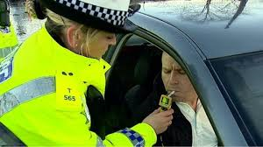
Scenario 4
To assist in the mentoring programme, you decide to have a summer barbeque for the children and their mentors.
The following day some information is passed to you regarding a couple of mentors.
One mentor comes to you and admits that they were breathalysed on their way home and were found to be over the drink drive limit.
One of the children comes to you and indicates that they want to change their mentor as they feel that the mentor made some inappropriate comments to them at the Barbeque.
After an internal investigation you decide not to use the two volunteers again as you think their conduct was not in line with what Intandem requires.
Are you required to make a referral to the PVG lists?

Slide 15
Scenario 5
Information is passed to you in relation to a historical allegation of abuse. It has been alleged that there was a continual period of improper conduct between a Mentor and a couple of children within your project.
The alleged abuse is said to have taken place between 2008 and 2010, which is prior to the implementation of the PVG scheme in 2011.
Based on the information that you gather and assess it is decided to remove the individual from all roles within group.
You look into the current circumstances of the mentor and discover that the individual is no longer active within the project having stopped volunteering for you in March of this year.
Are you required to make a referral to the PVG lists?

Slide 16
Key points
There are 2 lists of people unsuitable for regulated work
These lists are maintained by Disclosure Scotland
Offences are defined
For people who are listed
For organisations
In certain circumstances, organisations MUST make a referral
Dealing with other agencies is not the same as a referral
There is a form for making referrals
There is a process defined for DS to handle referrals

Slide 17
Services Offered by VSDS
Training
Online
In person at our office in Stirling
At a location chosen by you
Support
Form filling, enrolment
Advice
Guidance
Best Practice

Slide 18
Any Questions
Telephone – 01786 849777
Email – disclosures@volunteerscotland.org.uk
Web – http://www.volunteerscotland.net/disclosure-services

