Slide 1
Portfolio Day 23 August 2017
Adverse Childhood Experiences, Resilience and Mentoring
Sara Dodds, Scottish Government

Slide 2
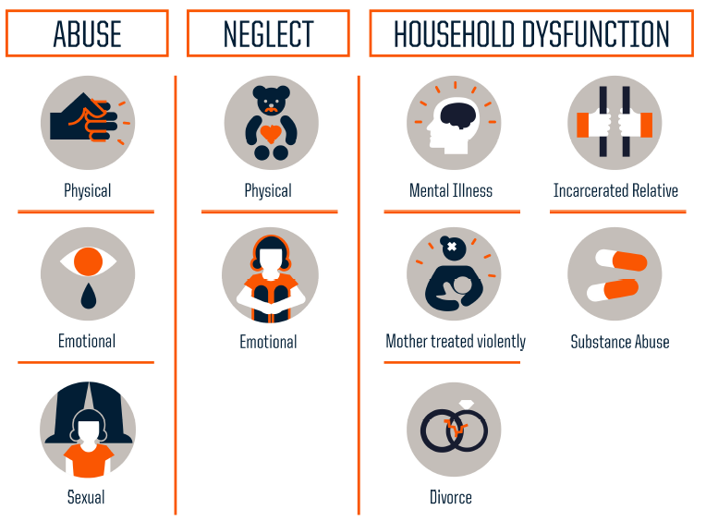
Notes:
Seen in the film the long-term impacts that ACEs can have on people without intervention
But equally
Impacts that supportive relationships can have on the resilience of people

Slide 3
Copyright 2013. Robert Wood Johnson Foundation. Full infographic is available at: www.rwjf.org/en/library/infographics/the-truth-about-aces.html
Notes:
3

Slide 4
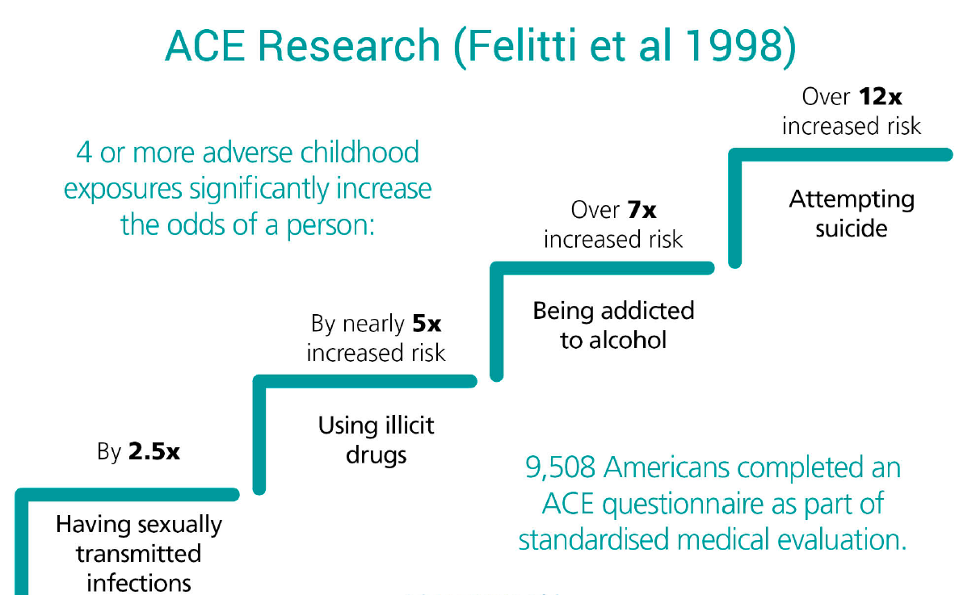
Felitti VJ, Anda RF, Nordenberg D, Williamson DF, Spitz AM, Edwards V, Koss MP, Marks JS. Relationship of childhood abuse and household dysfunction to many of the leading causes of death in adults: the adverse childhood experiences (ACE) study. Am J Prev Med. 1998;14:245–258.

Slide 6
Adverse Childhood Experiences ACEs - The Life Course
Death
Early Death
Non Communicable Disease, Disability, Social Problems, Low Productivity
Life Course
Adopt Health Harming Behaviours and Crime
Social, Emotional and Learning Problems
Disrupted Nervous, Hormonal
and Immune Development
ACEs Adverse
Childhood Experiences
Birth
Bellis 2016
Developed from Felitti et al. 1998

Slide 7
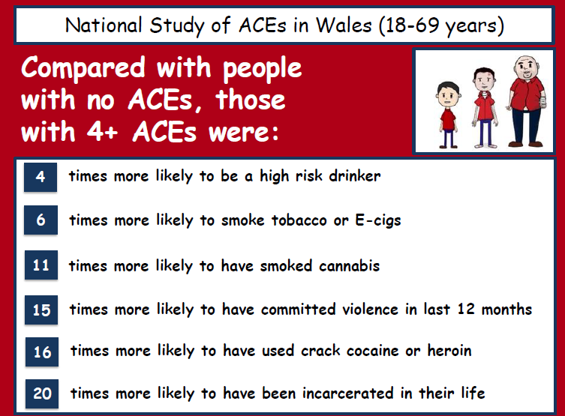
http://www.healthscotland.scot/media/1267/2_mark-bellis-presentation.pdf

Slide 8
http://www.healthscotland.scot/media/1267/2_mark-bellis-presentation.pdf

Slide 9
http://www.healthscotland.scot/media/1267/2_mark-bellis-presentation.pdf

Slide 10
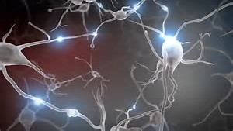
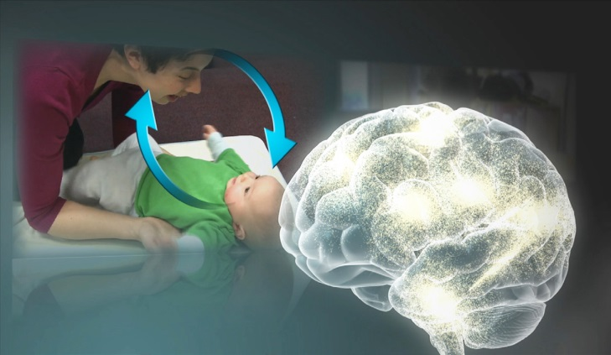
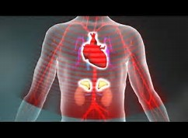
THREE CORE CONCEPTS IN EARLY DEVELOPMENT
Experiences Build Brain Architecture
‘Serve & Return’ Shapes Brain Circuitry
Toxic Stress Derails Healthy Development
http://developingchild.harvard.edu/

Slide 11
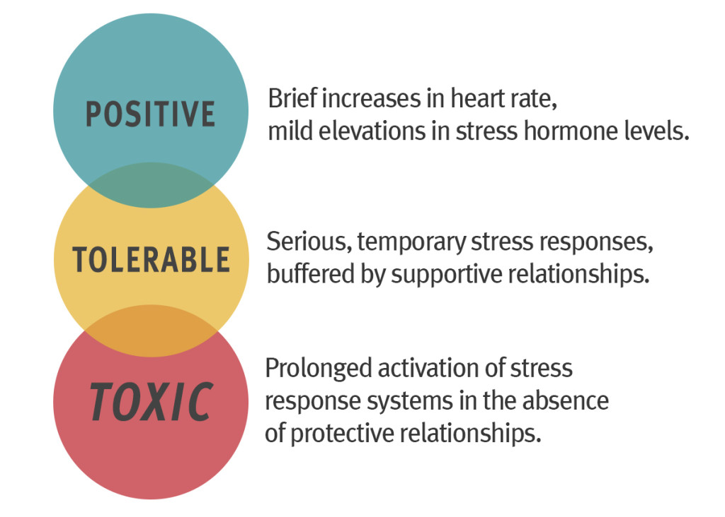
Three Types of Stress Response

Slide 12
“If had to boil this down to one thing for people to learn from this science, it’s to totally put to bed forever this sense that children who are born under disadvantaged circumstances are doomed to poor life outcomes. The science is saying, that’s just not true.”

Slide 13
Professor Bruce McEwen, GCPH Seminar: http://www.gcph.co.uk/events/155

Slide 14
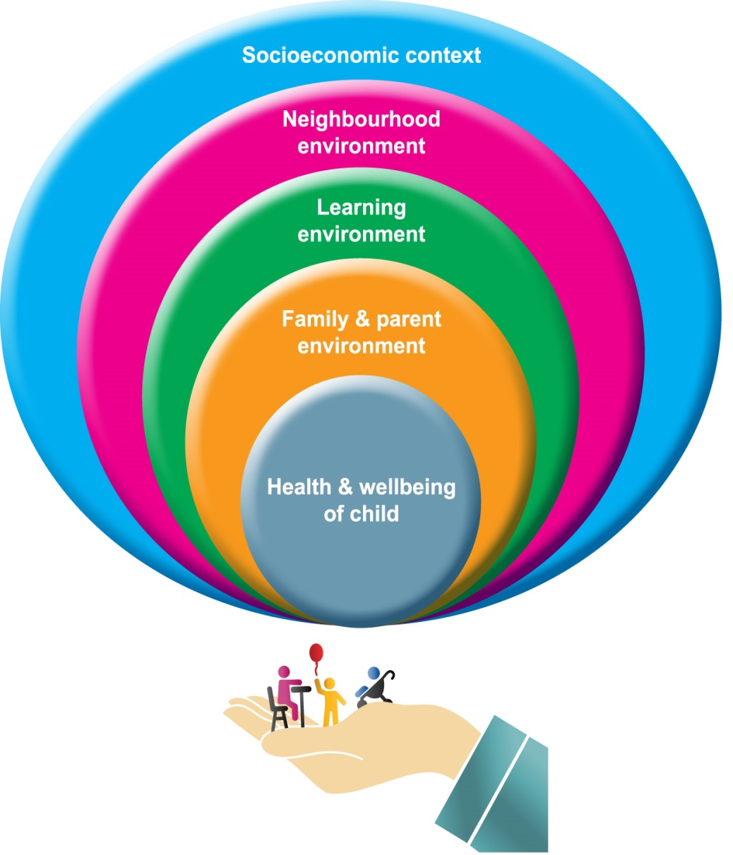
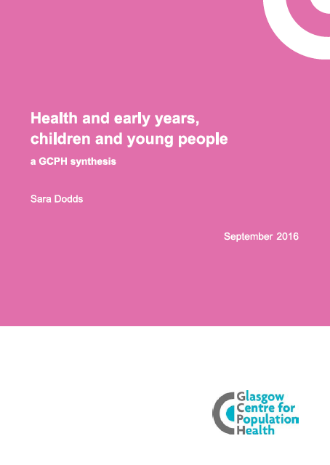

Slide 15
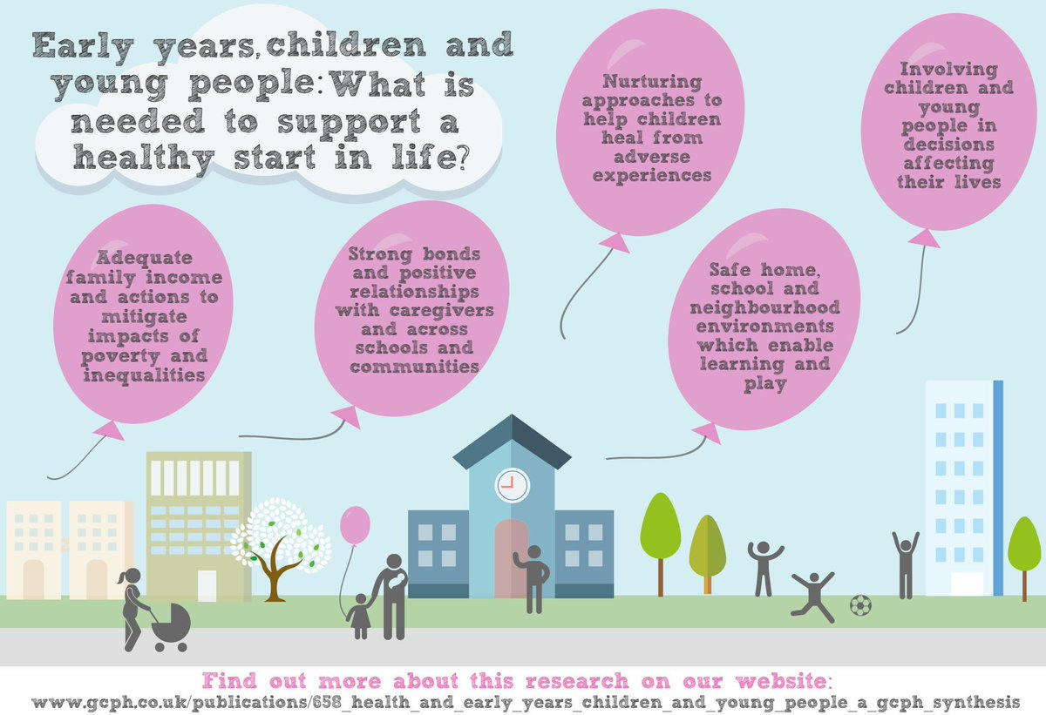

Slide 16
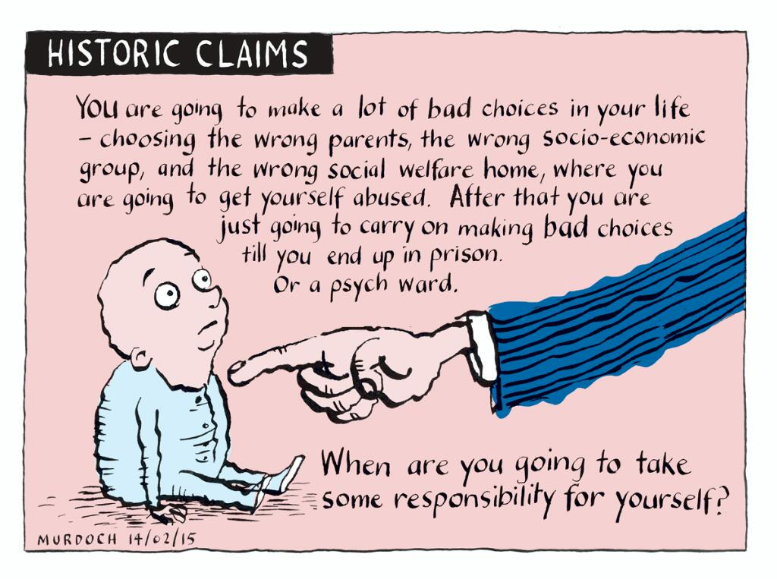

Slide 17
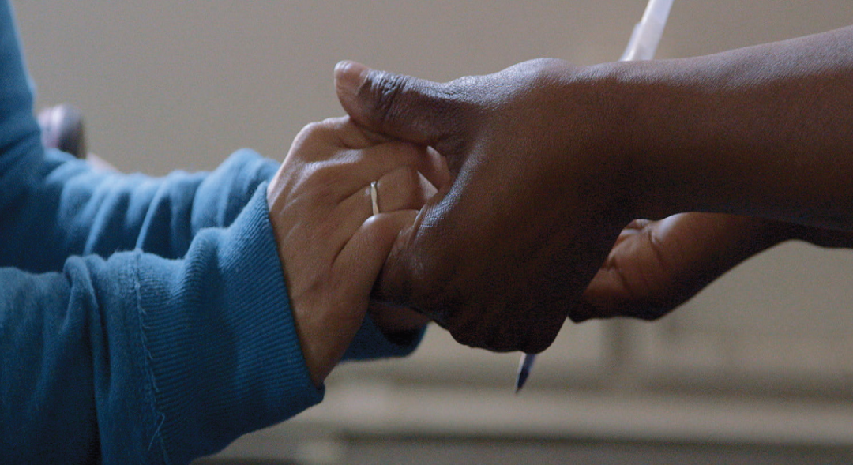
“What’s wrong with you?”
Blame
Shame
Punishment
“What happened to you?”
Understanding
Healing
Nurturing
Jane Stevens, GCPH Seminar: : www.gcph.co.uk/events/166

Slide 18
