Slide 1

Making children’s rights real in law, policy and practice
Wednesday 23rd January 2019
Juliet Harris, Director, Together

Slide 2
Children’s rights
can take power away from parents….
Agree? Disagree? Not sure?

Slide 3
Children think
that adults are good at listening to them….
Agree? Disagree? Not sure?

Slide 4
‘Children’s rights’, ‘play’ and ‘wellbeing’ are equal contributors to keeping children healthy, happy and safe…
Agree? Disagree? Not sure?

Slide 5
What are human rights and children’s human rights?

Slide 6
Human Rights
The Rights Holder (Being a Rights Holder means having a right to something - e.g. right holder = child )
The Object (The object of the Right is what you are entitled to - e.g. object = education)
The Duty Bearer (are the organisations, institutions that have a responsibility to give you the object of the Right - An obligation of the duty bearer is to give you what you are entitled to - e.g. duty bearer = local education authority)

Slide 7
The UN Convention on the Rights of the Child (UNCRC) 1989
..recognising that the child, for the full and harmonious development of his or her personality, should grow up in a family environment, in an atmosphere of happiness, love and understanding”.
UNCRC Preamble
UNCRC General Principles
Non-discrimination
(Article 2).
Best interests
(Article 3).
Survival and development
(Article 6).
Children’s participation (Article 12).
Provision
(survival needs, food and nutrition, health and shelter, an education)
Protection
(from all forms of harm and exploitation)
Participation
(as an active agent in their own lives and in society)

Slide 8
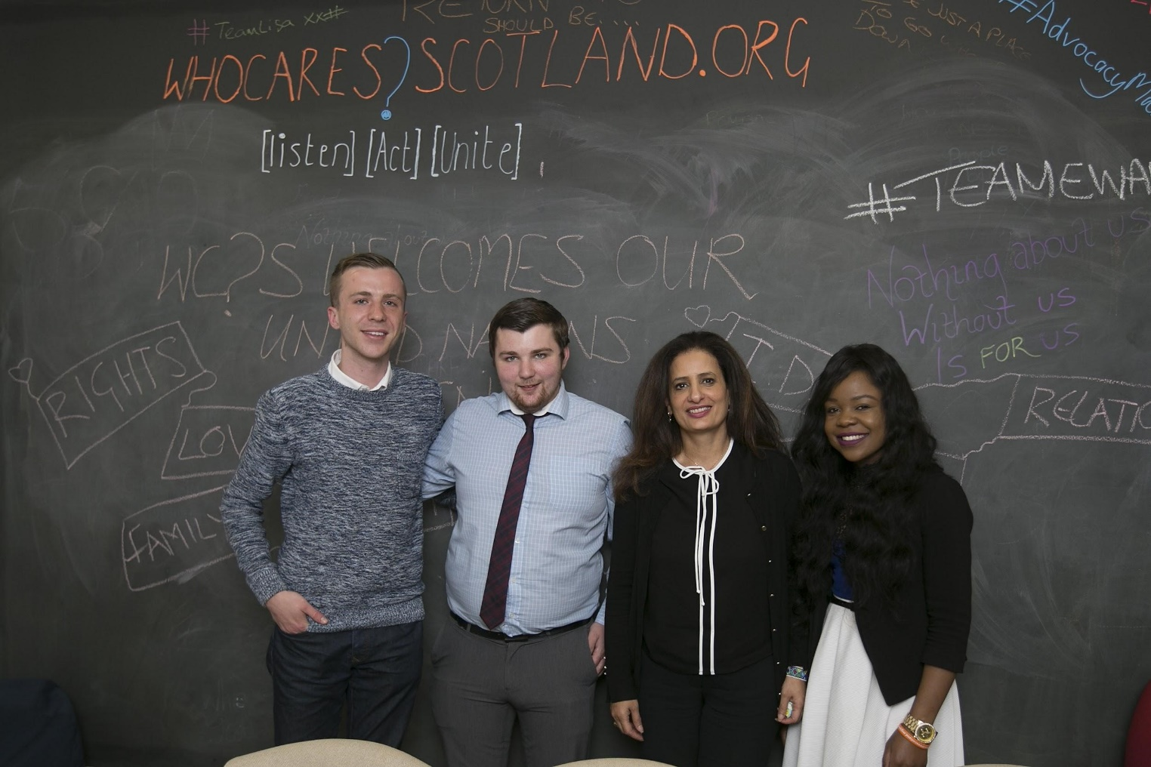
UN Concluding Observations 2016
150 recommendations made to improve children’s rights, informed by the views of children and young people across Scotland.
mental health
educational attainment
mosquito devices
child poverty
sibling contact
Gypsy/Traveller children
looked after children
age of recruitment to the armed forces
http://tbinternet.ohchr.org/_layouts/treatybodyexternal/Download.aspx?symbolno=CRC%2fC%2fGBR%2fCO%2f5&Lang=en

Slide 9
Examples of 2016 Concluding Observations
Ensure UNCRC is directly applicable and justiciable in Scots and UK law.
Introduce statutory obligation to conduct Child Rights Impact Assessments in the formulation of legislation
Establish structures for the active and meaningful participation of children in laws, policies, programmes and services.
Intensify its efforts to assist parents and legal guardians, including informal kinship carers, in the performance of their childrearing responsibilities and ensure that the removal of children from their families is always subject to thorough investigation and is in the best interests of the child and a last resort.
Ban the use of mosquito devices (repeated from 2008).
Prohibit the use of non-statutory stop and search, and ensure statutory use of stop and search is proportionate.
Prohibit the use of all physical punishment (repeated from 2008).
Raise the minimum age of criminal responsibility.

Slide 10
2016 Concluding Observations – what progress?
Ensure UNCRC is directly applicable and justiciable in Scots and UK law.
Introduce statutory obligation to conduct Child Rights Impact Assessments in the formulation of legislation
Establish structures for the active and meaningful participation of children in laws, policies, programmes and services.
Intensify its efforts to assist parents and legal guardians, including informal kinship carers, in the performance of their childrearing responsibilities
Ban the use of mosquito devices (repeated from 2008).
Prohibit the use of non-statutory stop and search, and ensure statutory use of stop and search is proportionate.
End stop of search of children for alcohol.
Prohibit the use of all physical punishment (repeated from 2008).
Raise the minimum age of criminal responsibility.

Slide 11
Equal protection
UN Committee 2016 Concluding Observation to ‘prohibit as a matter of priority all corporal punishment in the family, including through the repeal of legal defences, such as ‘reasonable chastisement’.
UK is one of only four countries within the European Union which has not yet committed to a ban on physical punishment.
Research shows physical punishment has the potential to damage children and carries the risk of escalation into physical abuse.
Link between childhood physical punishment and adult aggression.
Welsh Assembly is already looking at the repeal of the defence of ‘reasonable chastisement’.
John Finnie MSP introduced the Children (Equal Protection from Assault) (Scotland) Bill in September 2018 (http://www.parliament.scot/parliamentarybusiness/Bills/109156.aspx). The Scottish Government has committed to support it through the Scottish Parliament.

Slide 12
Age of criminal responsibility
UN Committee 2016 Concluding Observation to ‘raise the minimum age of criminal responsibility in accordance with acceptable international standards’.
The age of criminal responsibility is currently 8 years old - the lowest in Europe and one of the lowest in the world.
In 2015, 215 children aged 8-11 years were referred to the Children’s Reporter for offending behaviour. Of these, 39% children had disabilities and physical and/or mental health problems, 25% had been victims of physical and/or sexual abuse.
The majority of these children will not go on re-offend. Incidences of 8-11 year-old committing more serious offences are rare.
An offence ground that is accepted or established via the Children’s Hearings system will lead to a criminal record for that child.
The Age of Criminal Responsibility (Scotland) Bill (http://www.parliament.scot/parliamentarybusiness/Bills/107986.aspx) is at Stage 2 in the Scottish Parliament. This currently proposes raising the minimum age of criminal responsibility to 12 years-old.

Slide 13
Incorporation of the UNCRC into domestic law
The UN Committee has repeatedly raised the need to incorporate the UNCRC into domestic law
The rights enshrined in the UNCRC are currently ‘guiding’ rather than ‘binding’ in Scots law.
The Children and Young People (Scotland) Act 2014 placed the UNCRC on statute for the first time but fell far short of ‘full incorporation’.
The 2017-18 Programme for Government committed to ‘undertake an audit of UNCRC implementation with a view to incorporating the principles into law’.
The 2018-19 Programme for Government committed to ‘incorporate the principles of the UN Convention on the Rights of the Child into domestic law”.
Scottish Government has indicated that this means ‘the intent of all the articles’ of the UNCRC. It remains unclear as to when this will be taken forward. (https://www.gov.scot/Publications/2018/09/6276)

Slide 14
Mosquito devices
UN Committee 2016 Concluding Observation to ‘prohibit the use in public spaces of acoustic devices used to disperse gatherings of young people (so-called ‘mosquito devices’).
Mosquito devices emit sounds at frequencies that can generally only be heard by children and which is designed to be uncomfortable and unpleasant.
Manufactures boast that devices are: “UNBELIEVABLY annoying to the point where the kids CANNOT stay in the area being covered”
Devices are indiscriminate and can be as disturbing for a baby in a pram as they are to a teenager.
Children across Scotland are encountering mosquito devices in areas where local authorities believe no devices are installed.
Scottish Government say it does not “support use of mosquito devices against children”.
Yet no action is being taken to stop the use of mosquito devices.

Slide 15
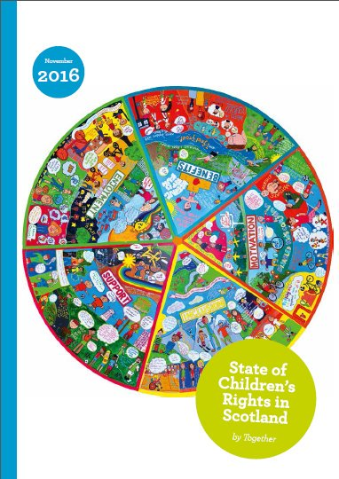
State of Children’s Rights in Scotland 2016
NGO perspective - provides a non-government perspective on the extent to which children in Scotland are able to enjoy the human rights enshrined in the UNCRC and other international treaties.
Baseline - offers a baseline against which progress in implementing recommendations made by the UN Committee on the Rights of the Child and other international treaty bodies can be measured.
Recommendations - reflects on areas where progress is being made and identifies where further efforts are needed.
http://togetherscotland.org.uk/pdfs/TogetherReport2016.pdf

Slide 16
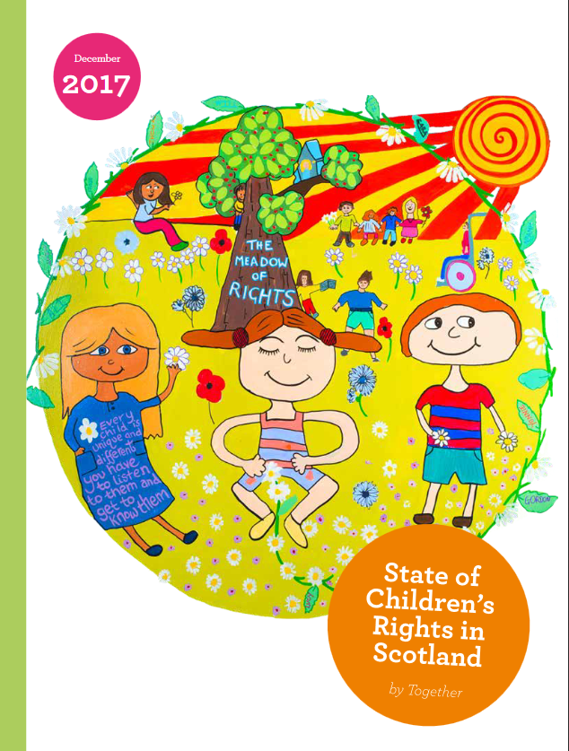
State of Children’s Rights in Scotland 2017
Rights-based practice – sets out promising rights-based practice taken by public bodies across Scotland.
Case studies – includes a wide range of case studies from Together’s members that illustrate how a rights-based approach can make a significant difference to children & young people’s lives.
Tool for public bodies – provides ideas, inspiration and evidence to public bodies to support the implementation of the Children & young People (Scotland) Act 2014.
http://togetherscotland.org.uk/pdfs/2017_Online_V11.pdf

Slide 17
Taking a children's rights approach.

Slide 18
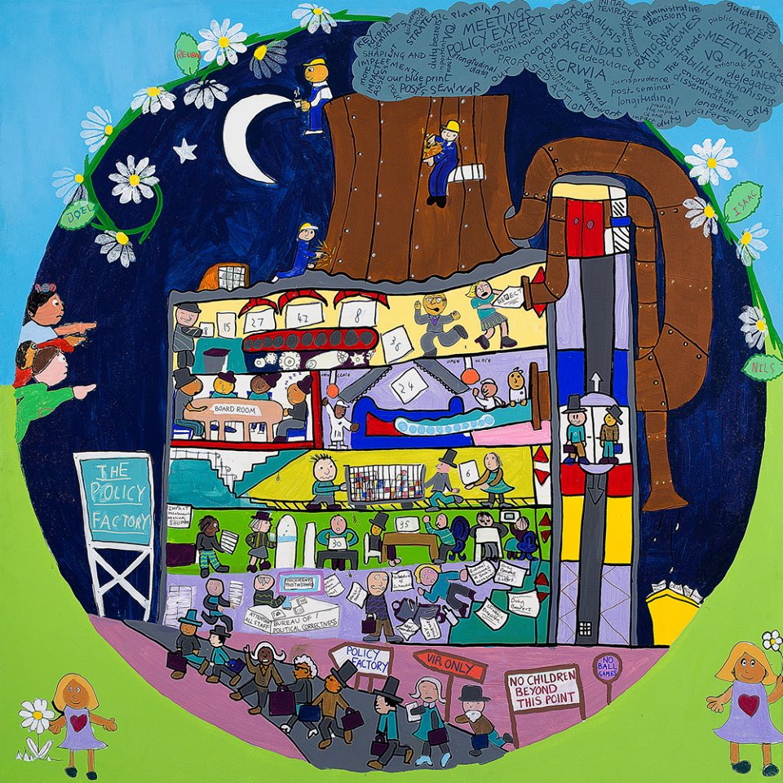
What a child rights approach
doesn’t look like!
Children on the outside looking in.
Picking and choosing which rights to consider and uphold.
Big decisions being made about children without seeking their views.
Grand statements that mean nothing to children’s everyday lives.

Slide 19
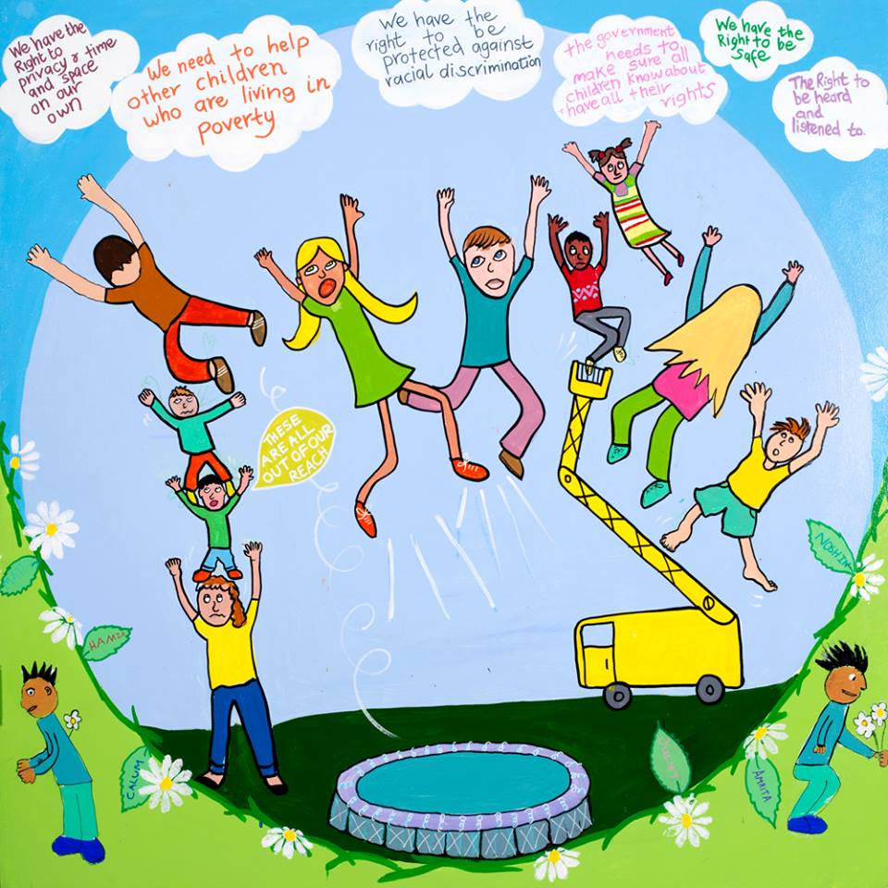
What we shouldn’t do!

Slide 20
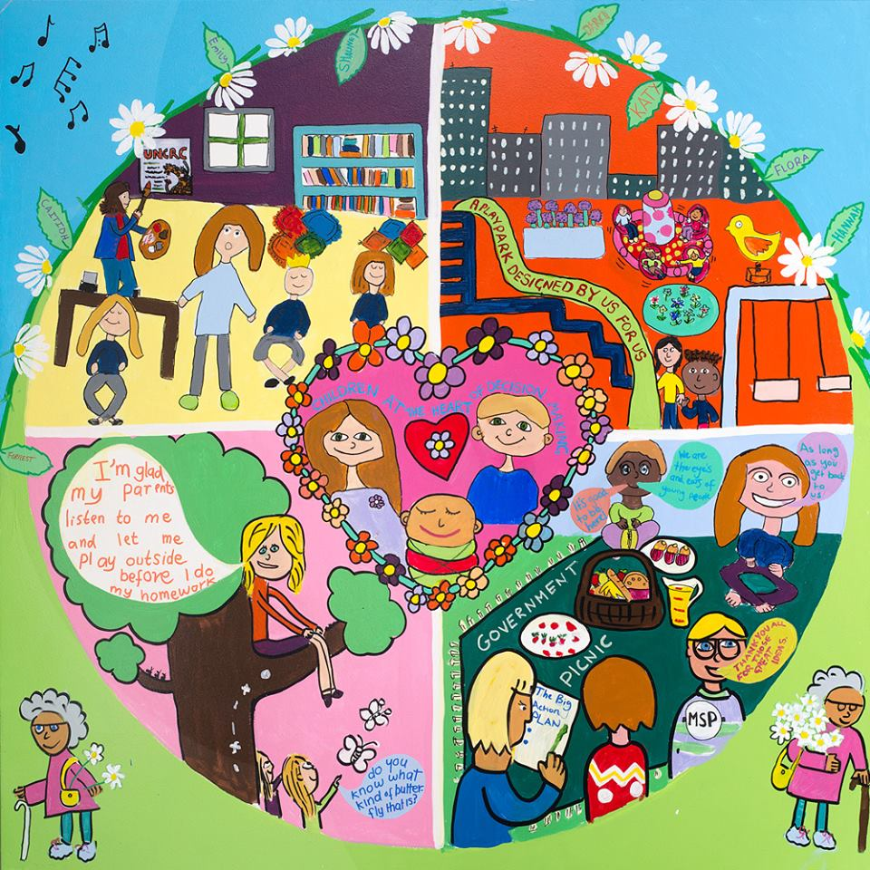
What a child rights approach
does look like!
It’s about relationships!
Children are treated with dignity, respect and feel valued.
Children are involved in decisions about their lives and the communities they live in.
Children know they have safe spaces in which they can share their views and experiences and influence the world around them.

Slide 21
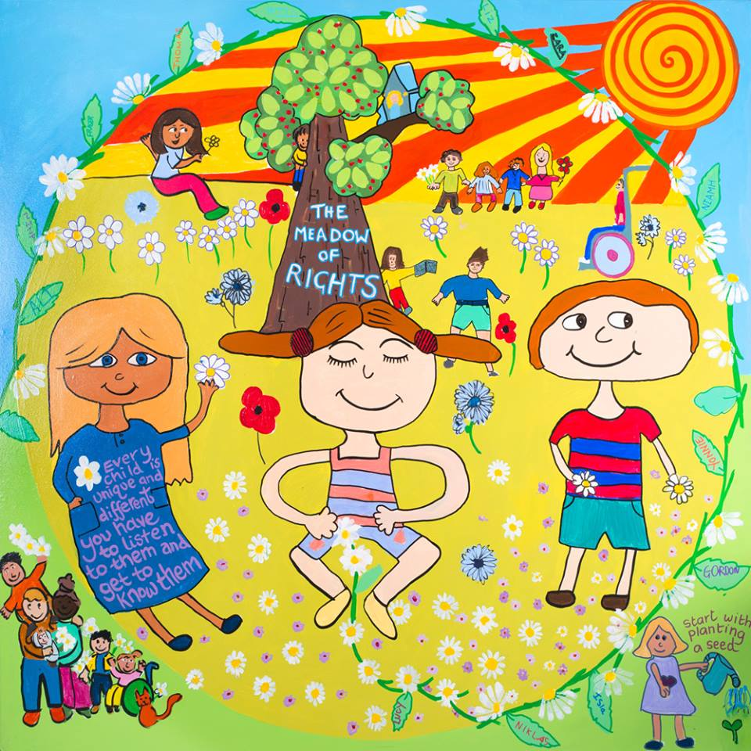

What does taking a child rights approach create?
Children feel safe, happy, healthy and valued.
Improved emotional wellbeing
Improved relationships with peers and adults
Increased commitment to school and learning
Evaluation with Social Research Unit, Dartington 2015

Slide 22
Children’s Rights Provisions (Part 1)
A duty on Scottish Ministers to “keep under consideration” steps to further children’s rights and “if they consider it appropriate to do so, take any of the steps identified”
A duty on Scottish Ministers to promote and raise awareness of children’s rights and report on progress
A duty on Ministers and across the public sector to report on how the UN Convention on the Rights of the Child is being furthered but stopping considerably short of full incorporation
New powers for Scotland’s Commissioner for Children and Young People to conduct investigations on behalf of individual children

Slide 23
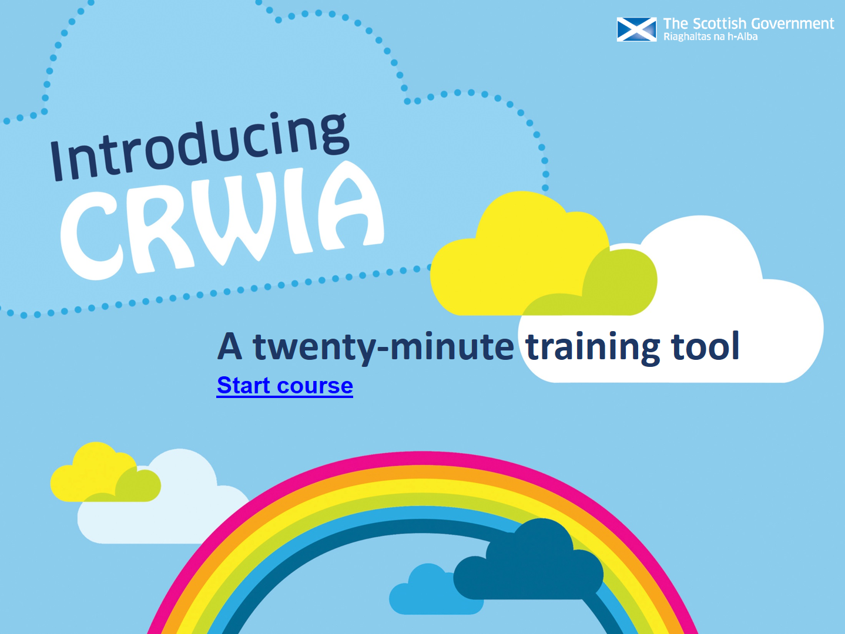
Children’s Rights and Wellbeing Impact Assessments (CRWIA)
“CRWIA is intended to help us champion the interests of children, as well as challenge us to think about what more we can do to place children and young people at the centre of our policies”.
http://www.gov.scot/Resource/0049/00497083.ppsx

Slide 24
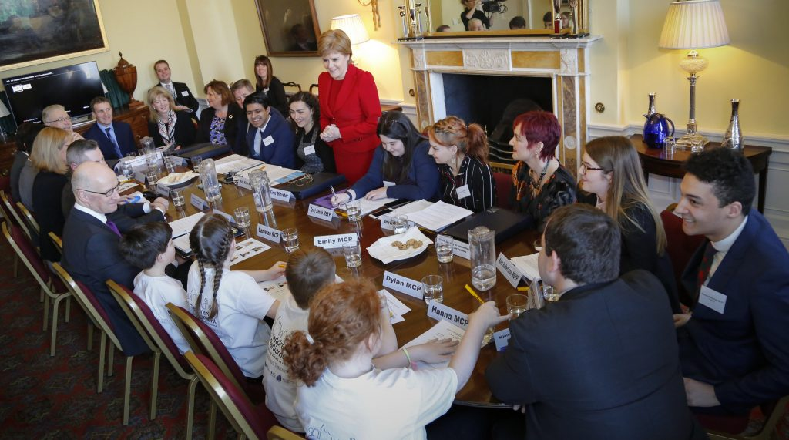
Duty on Scottish Ministers – the views of children
Annual meeting between children & young people and Scottish Cabinet with discussions on:
Child poverty
Mental health
Brexit
Education
Equal protection
Feeling safe
UNCRC recommendations
https://youtu.be/AYQEIcQisCY

Slide 25
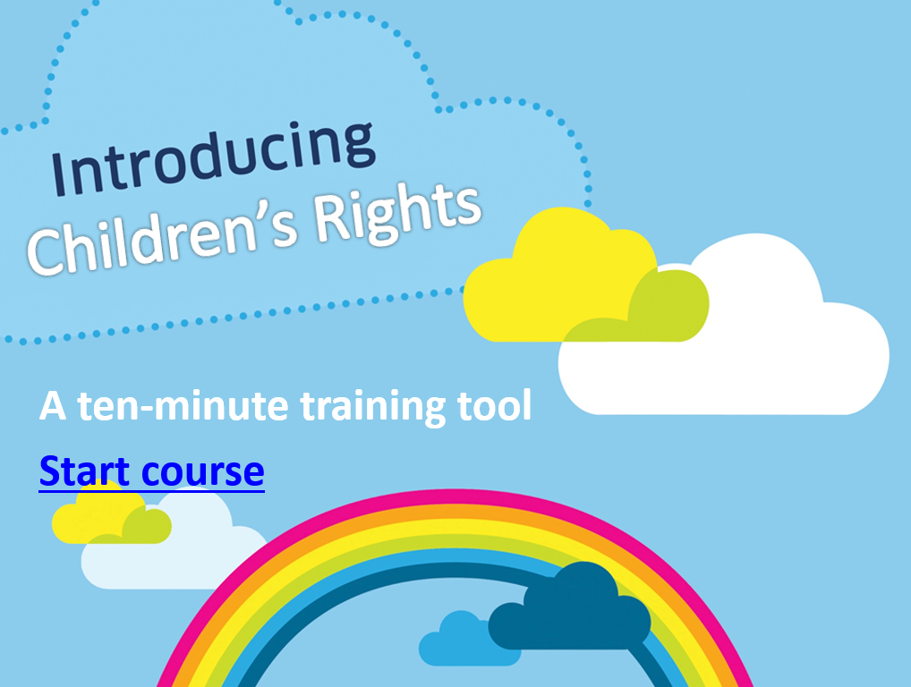
Duty on Scottish Ministers
- awareness raising
10 minute online training on the UNCRC now available.
All CYPEIF/ALEC funded organisations have a grant objective to raise awareness and understanding of the UNCRC – support materials available online.
www.gov.scot/Topics/People/Young-People/families/rights/CYPFEIF-ALEC

Slide 26

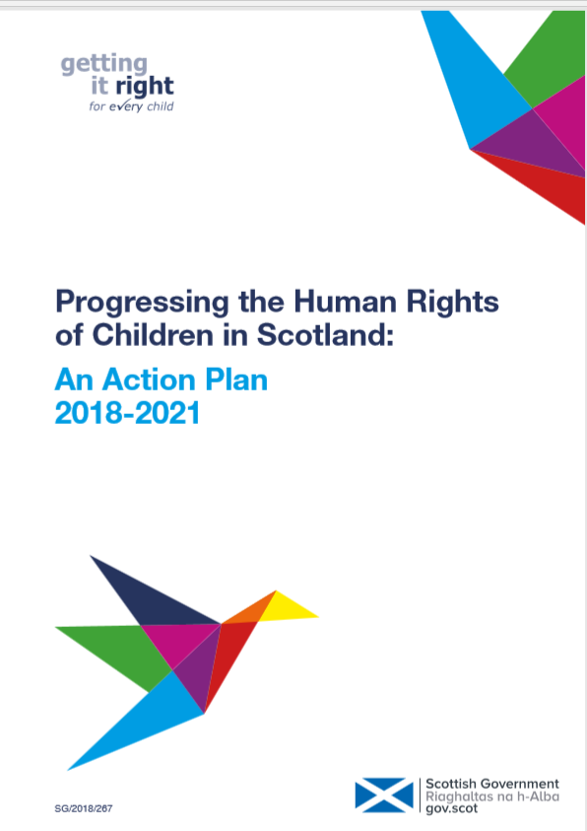
Action Plan for Children’s Rights – 2018-2021
We will evaluate the Child Rights and Wellbeing Impact Assessment (CRWIA) process and further support and promote its use:
We will update the templates, guidance and training materials for the CRWIA process and making these publicly available on the Scottish Government Website.
We will encourage the use of the CRWIA materials by Public Authorities and children & young people’s organisations.
We will develop an impact evaluation process for the CRWIA.
Delivering for Today,
Investing for Tomorrow
The government’s programme
for Scotland 2018-19
https://www.gov.scot/publications/progressing-human-rights-children-scotland-action-plan-2018-2021/

Slide 27
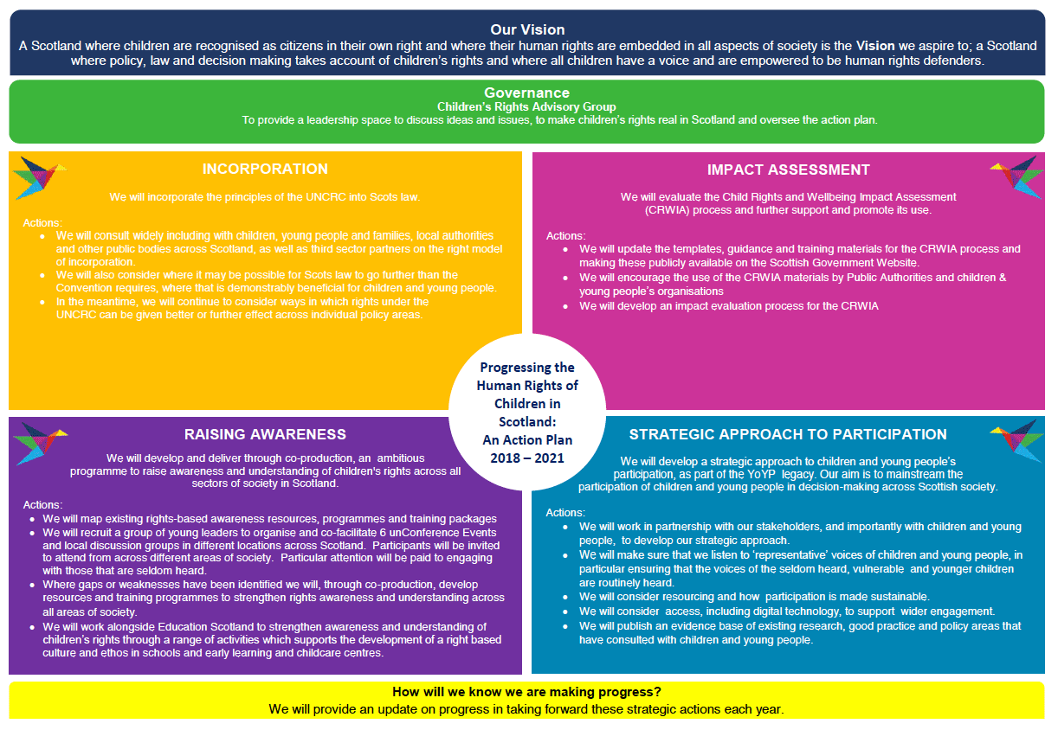
Delivering for Today,
Investing for Tomorrow
The government’s programme
for Scotland 2018-19
https://www.gov.scot/publications/progressing-human-rights-children-scotland-action-plan-2018-2021/

Slide 28
Programme for Government commitments – 2017, 2018
2017
comprehensive audit on the most practical and effective way to further embed the principles of the UNCRC into policy and legislation, including the option of full incorporation into domestic law.
setting up of an independent Advisory Group on Human Rights Leadership tasked with making recommendations on how Scotland can lead by example in the field of human rights, specifically economic, social, cultural and environmental rights.
2018
incorporate the principles of the UNCRC into domestic law.
“different ways to achieve this” and “particular complexities in relation to the UNCRC which require to be worked through”
“consider where it may be possible for Scots law to go further than the Convention requires”
Delivering for Today,
Investing for Tomorrow
The government’s programme
for Scotland 2018-19

Slide 29
Embedding children's rights
into policy and practice.

Slide 30
For children…
It could change what people do, like the council could see our mural and think “Oh, this would be a good thing to build!” and they could work with an urban planner for where to put it. I feel good doing this project and like our dreams could come true.’ MCP age 9
Increased self-confidence
Improved communication skills
Improved relationships
Better connections within the community
Improvement in emotional self-regulation
Increased awareness and respect from adults
‘I’ve changed since joining this group. I have more friends. I know others who are looked after. I’m more confident now, I’m able to talk to more people’ MCP age 10

Slide 31
For parents/carers
& families….
As a newcomer staying in a new build away from the high street, I never really feel part of this community or access any local facilities. This project has made me more aware of how we should access and support local facilities and businesses to keep the community thriving for our children’s future. Parent
Increased awareness of children's potential and abilities
Pride in children's achievements
Increased understanding of the difference between tokenistic engagement and educational engagement
Increased commitment to their local community
Increased commitment to engage differently with their children
My child was/is going through some tough times with behaviour issues and I believe the project gave him a valuable external focus and has helped him learn new skills and given him a boost to his self-esteem so I cannot underestimate the benefits of the project to him and our family. Parent

Slide 32
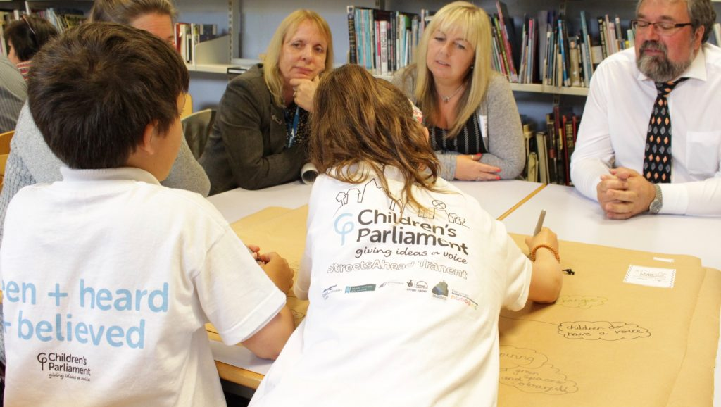
For communities…
Pride in local children's achievements
Greater engagement and connection with local children
Changed perceptions of children
New understandings of children's potential and abilities
Greater understanding of the value of genuine engagement with children

Slide 33
For professionals…
It has been nice for me to get to know the pupils on a deeper level. I used to think of each child as 'good at maths', 'needs help in literacy', now I know them better as individuals. Doing our Best has allowed me to get to know my pupils. Teacher
The work of the Children’s Parliament to increase awareness and understanding of children's potential and abilities led to:
  Financial commitment to enable children to participate in United Nations Committee on the Rights of the Child Day of Discussion on Children's Rights and the Environment in Geneva, September 2016
  Establishment of a Youth Reference Group
  New project with inbuilt training for teachers, other professionals and parents/carers
It has allowed real and genuine engagement with children from very senior members of the council – and their views are genuinely being taken seriously. This has helped to embed a culture of seeking the views of young people across the council. Partner

Slide 34
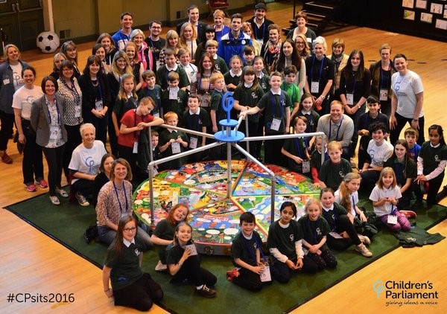
As a result of a rights-based approach, children have…
Improved emotional wellbeing
Improved relationships with peers and adults
Increased commitment to school and learning
Evaluation with Social Research Unit, Dartington 2015

Slide 35
What does a rights-based approach look like? It’s all about relationships!
Family support
Schools and communities
Policing
Healthcare
Transport
Children & young people
Adults (parents, carers, teachers, social workers, medical professionals, policy-makers, MSPs)
Rights-based child protection
- Focus on prevention
- Listening to children and young people at every step
- Empowerment and participation central to systems, policy and practice
Honest, trusting, listening, supporting, consistent, informative, individual, safe environment.
National and local government
NGOs
Parents and carers

Slide 36
Frameworks and tools to support a rights-based approach
Children’s Rights and Wellbeing Impact Assessment
Part 1 Guidance, Children & Young People (Scotland) Act 2014
UN Committee Concluding Observations 2016
State of Children’s Rights report 2016
Common Core of Skills, Knowledge, Values and Understanding for the Children’s Workforce
PANEL principles
7 Golden Rules of Participation

Slide 37
Children’s Rights and Wellbeing Impact Assessments (CRWIA)
“CRWIA is intended to help us champion the interests of children, as well as challenge us to think about what more we can do to place children and young people at the centre of our policies”.
http://www.gov.scot/Resource/0049/00497083.ppsx

Slide 38
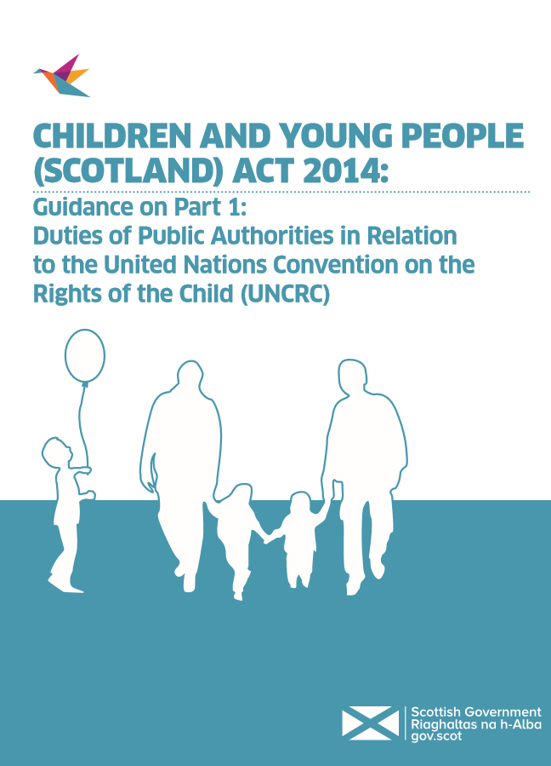
Part 1 Guidance - Children & Young People (Scotland) Act 2014
“A rights-based approach takes these obligations and provides a means of embedding rights across services, policy and practice. It provides a framework for monitoring and evaluating progress on realising rights in different contexts and settings.”
http://www.gov.scot/Resource/0049/00497083.ppsx

Slide 39
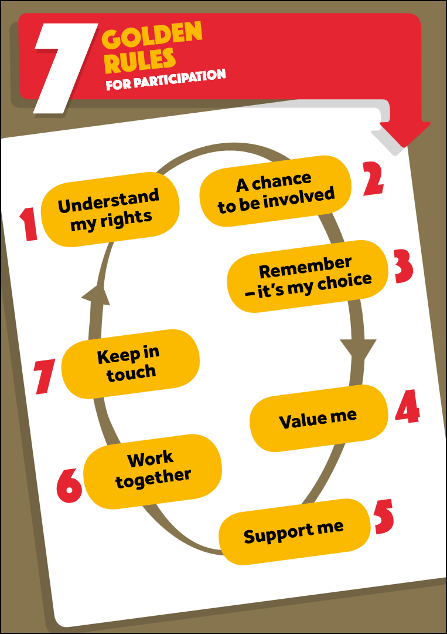
Golden Rules for Participation
Reflection…
What are we doing?
What has worked well?
What have we learned?
What should we be doing better?
Forward planning…
What will we do differently?
Why will we do it?
How will we do it?
When will we do it?
https://www.cypcs.org.uk/education/golden-rules

Slide 40
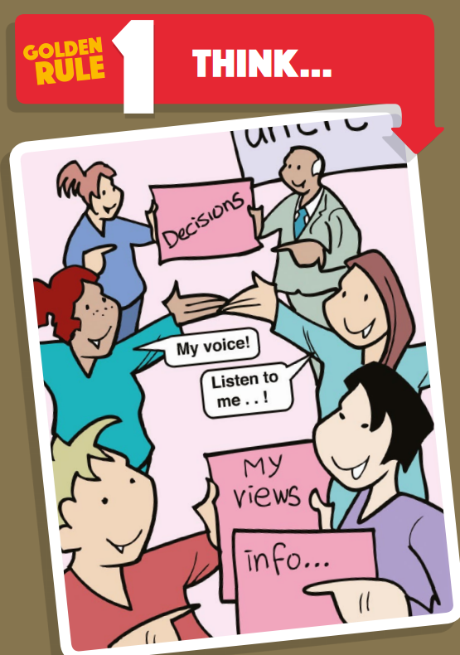

Slide 41


Slide 42
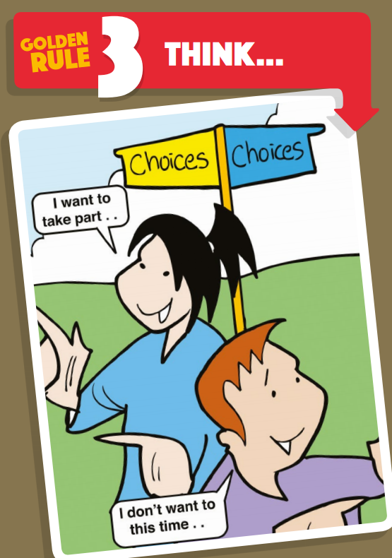

Slide 43
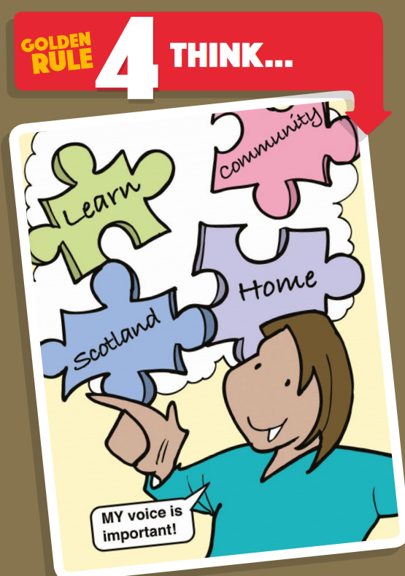

Slide 44
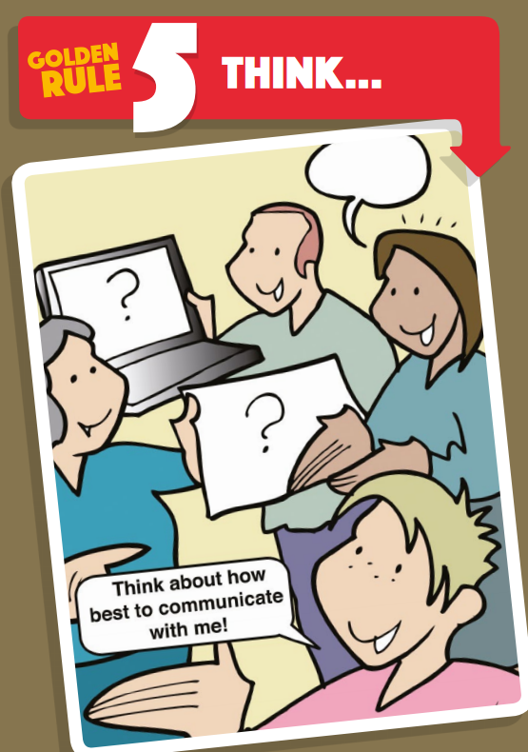

Slide 45
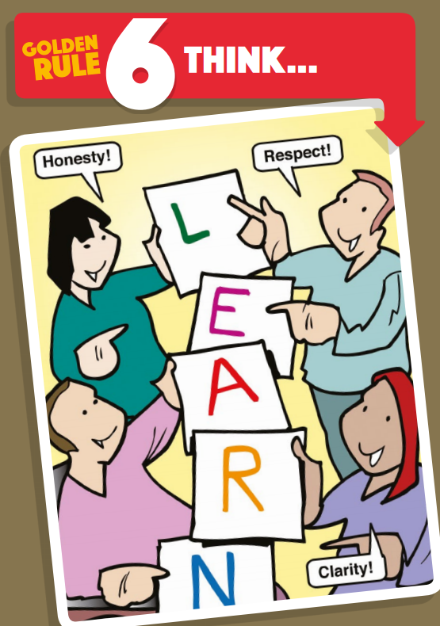

Slide 46
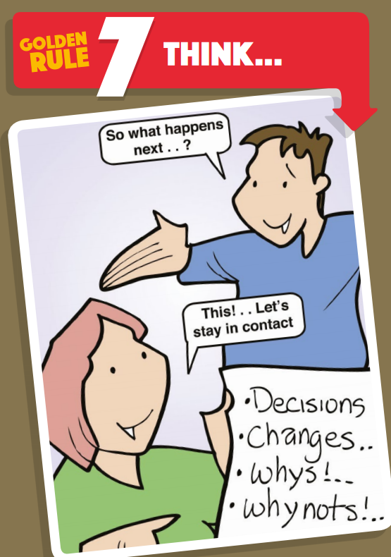

Slide 47
Common Core of Skills, Knowledge, Understanding and Values
Relationships!
Relationships!
http://www.gov.scot/Resource/0039/00395179.pdf

Slide 48
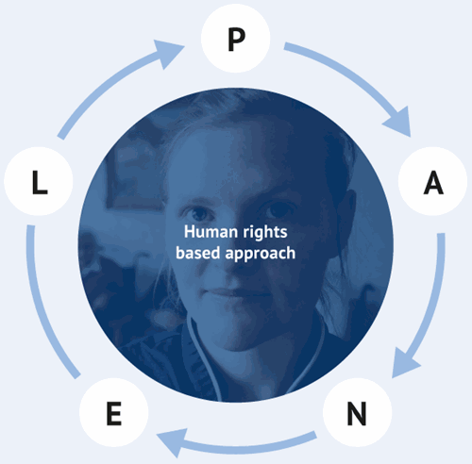
PANEL Principles
Participation - People should be involved in decisions that affect their rights.
Accountability - There should be monitoring of how people’s rights are being affected, as well as remedies when things go wrong.
Non-Discrimination and Equality - All forms of discrimination must be prohibited, prevented and eliminated. People who face the biggest barriers to realising their rights should be prioritised.
Empowerment - Everyone should understand their rights, and be fully supported to take part in developing policy and practices which affect their lives.
Legality - Approaches should be grounded in the legal rights that are set out in domestic and international laws
http://www.scottishhumanrights.com/media/1409/shrc_hrba_leaflet.pdf

Slide 49
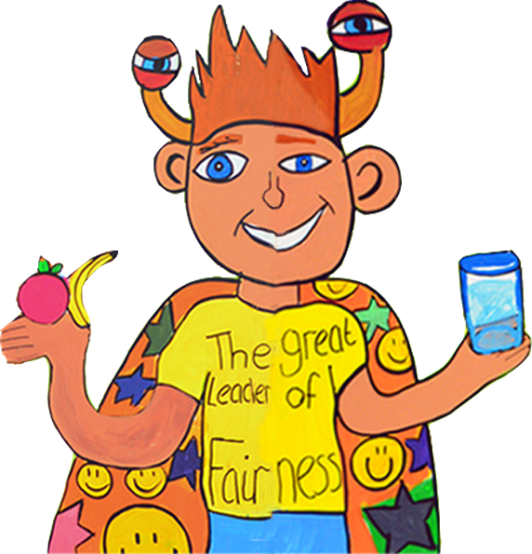

The Unfearties
Children’s Parliament is 21 this year. To mark this special birthday, we are creating an inspiring and brave band of Unfearties - individuals who are not feart, are making a difference in children’s lives, and who are willing to speak up for, and stand alongside, children.
An Unfeartie…
Listens to children
Views children as capable and an asset to their communities
Strives to ensure children’s voices are heard
Challenges infringements of children’s human dignity
Helps children learn the values of honesty, empathy, respect and social justice
Promotes greater awareness + understanding of children’s rights
Speaks up about their Unfeartie role and spreads the message about how to sign up
Become an Unfeartie
The Great Leader of Fairness, from the Fairer Fife Mural, 2015

Slide 50
Reflecting on our rights-based approach in our work…
What does a rights based approach look like locally in your intandem project?
What is needed on a national level – what should we do/add/change?

Slide 51
Making children’s rights real in law, policy and practice
Wednesday 23rd January 2019
Juliet Harris, Director, Together

